Slide 1
Scary Stories from the
Comptroller’s Office
Isreal J. Miller
Gray Reed

Slide 2
Isreal J. Miller
Leader of the State and Local Tax Practice Group
B.A., University of Texas at Austin
M.S., Personal Financial Planning, Texas Tech University
J.D., Texas Tech University School of Law
LL.M., Taxation, Southern Methodist University Dedman School of Law
Experience
Served for 5 years as an attorney in the Administrative Hearings Section of the Texas Comptroller of Public Accounts

Slide 3
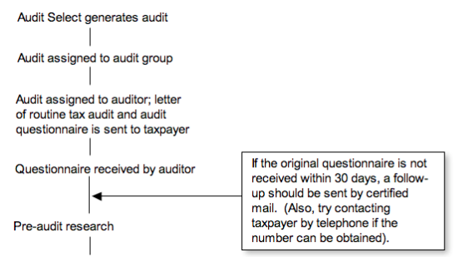
I Just Got a Letter from the Texas Comptroller…

Slide 4
And Now All of These Firms Are Soliciting My Clients.

Slide 5
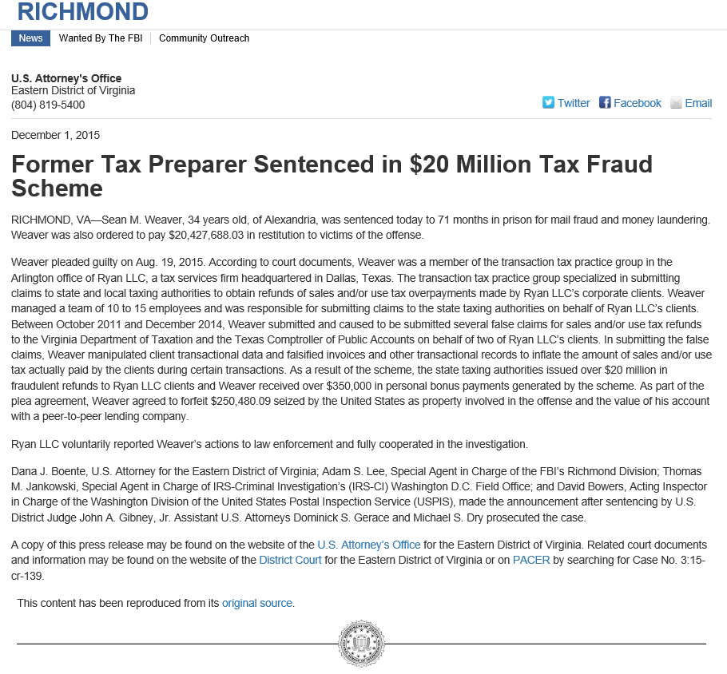

Slide 6
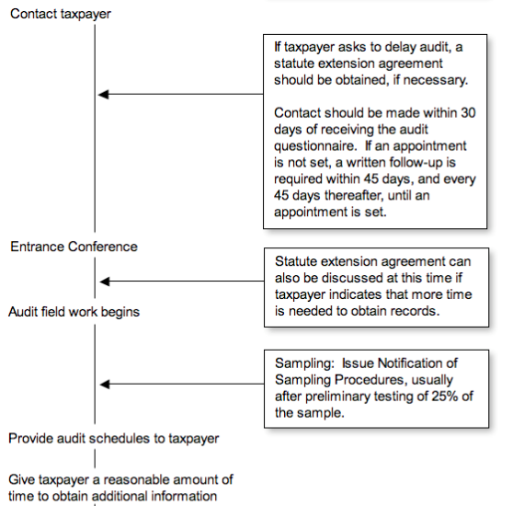
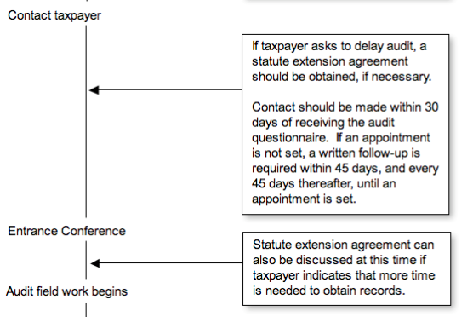

Slide 7
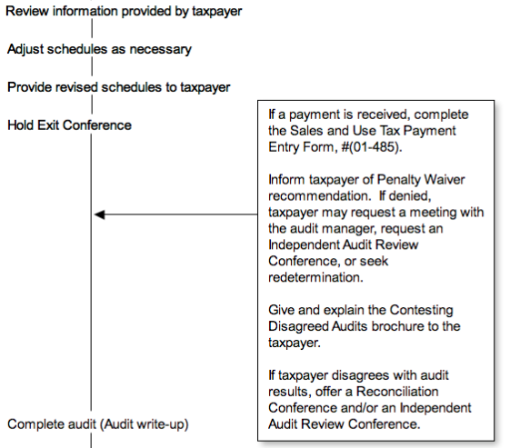

Slide 8
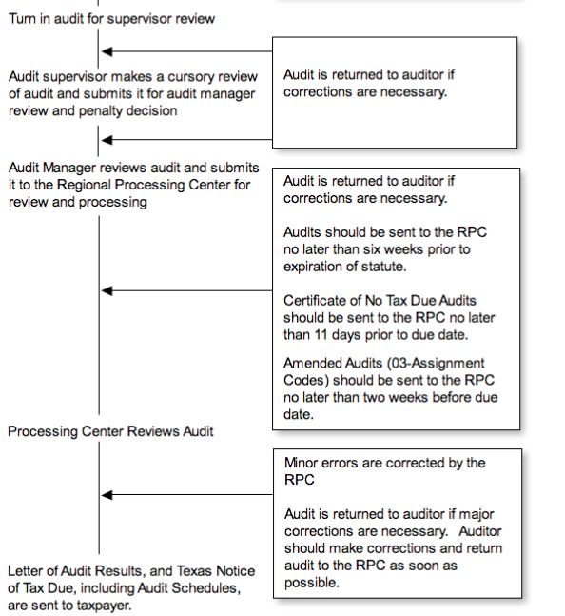

Slide 9
Audit Elements

Slide 10
Audit Elements
An auditor’s primary function is to determine if a tax has been correctly reported and paid. This should be done in the shortest possible time, and should create the least possible inconvenience for a taxpayer.

Slide 11
Audit Elements
Five essential elements are used to meet audit objectives:
Taxpayer Relations
The benefit derived from developing a good relationship with a taxpayer is two-fold. The taxpayer tends to become more comfortable with the audit situation, which allows the audit process to flow more smoothly.

Slide 12
Audit Elements
2. Planning Activities
Planning an audit begins when an audit assignment is received. It is very important that all audit activities, including pre-audit preparation, be documented in the Audit Plan.

Slide 13
Audit Elements
Here is a tidbit from Comptroller’s Decision No. 102,268 (2014):
If only one fact is clear from the evidence, it is that the auditor was extremely frustrated by Petitioner’s document production. She found Petitioner’s documentation incomplete, unreliable, and insufficiently explained. The ALJ finds that the audit documentation demonstrates, prima facie, that the auditor’s use of estimation methodologies was authorized.
The audit plan is helpful in preparing a statement of grounds to contest audit results. It is available through an open records request emailed to: open.records@cpa.texas.gov and supported with a valid power of attorney.

Slide 14
Procedures to Obtain Information
Submit a request by mail, fax, email or in person according to a governmental body's reasonable procedures.
Include enough description and detail about the information requested to enable the governmental body to accurately identify and locate the information requested.
Cooperate with the governmental body's reasonable efforts to clarify the type or amount of information requested.

Slide 15
Information to be Released
You may review it promptly, and if it cannot be produced within 10 working days the public information officer will notify you in writing of the reasonable date and time when it will be available.

Slide 16
Cost of Records
You must respond to any written estimate of charges within 10 days of the date the governmental body sent it or the request is considered automatically withdrawn. If estimated costs exceed $100.00 the governmental body may require a bond, prepayment or deposit. Make a timely payment for all mutually agreed charges. A governmental body can demand payment of overdue balances exceeding $100.00, or obtain a security deposit, before processing additional requests from you.

Slide 17
Audit Elements
3. Examination of Records
Gather and evaluate sufficient records to provide an adequate basis for determining the accuracy of the tax returns filed.

Slide 18
Comptroller’s Decision 105,774 (2013)

Slide 19
Application of the Law
An auditor must be familiar with the requirements of the law administered. Copies of all tax laws are available in every audit office.
Rules issued by the Comptroller and registered with the Secretary of State have the effect of law and serve as guides for interpreting laws. Comptroller employees may view the rules on the Comptroller's internal Web site. The general public may view the rules via the Comptroller's website.
Another reference source is memoranda issued by the Comptroller’s office.

Slide 20
Audit Elements
4. Documentation
Use documentation to note pertinent audit evidence discovered during an audit. A well-documented audit will consist of a complete record of evidence examined by the auditor to support any findings. Also, document any oral statements made by the taxpayer which may be important to support any audit findings.

Slide 21
Audit Assignment
The first step in the audit process occurs when the auditor receives the audit assignment.
Pre-Audit Research and Review
This research period is when the auditor reviews information about the account and the business to be audited.

Slide 22
Taxpayer Contact
The first contact with the taxpayer occurs after initial pre-audit research and review has been completed. The auditor calls the taxpayer to set an appointment to begin the audit.
Entrance Conference
The first face-to-face meeting with the taxpayer occurs during the entrance conference. During this meeting, the auditor will obtain more information regarding the taxpayer’s business, answer taxpayer questions, discuss records required, and ask any other questions which will help in completing the audit.

Slide 23
Examination of Taxpayer Records
It is important to determine how the taxpayer calculated the reported amounts. The auditor should have the taxpayer show how the return was prepared. Reconcile appropriate accounts with the taxpayer history after establishing the validity of summary records.
Exit Conference
Upon completion of the field work, the auditor will meet with the taxpayer and explain the results of the audit and administrative remedies.

Slide 24
Reconciliation Conference
A reconciliation conference is available to a taxpayer who disagrees with the audit findings. The purpose of this conference is to re-evaluate the audit findings and resolve any taxpayer disagreements, if possible. The conference usually includes the taxpayer, the auditor, the group supervisor and/or audit manager.

Slide 25
Independent Audit Review Conference
This conference may be held in addition to or instead of the reconciliation conference. An independent audit review conference is an informal meeting of the Independent Audit Reviewer (IAR), the taxpayer, the auditor, and the group supervisor and/or audit manager. The IAR is an impartial Comptroller employee with tax and audit expertise who will listen to both sides and try to resolve any is agreements before the audit enters the hearings process. The IAR reports directly to the assistant director of Tax Administration and does not work at any Comptroller office that conducts audits.

Slide 26
Audit Finalization (Audit Write-up)
This is the process of summarizing the results of the examination.
Audit Review
When audit write-up is completed, it will be reviewed in the audit office and at the Regional Processing Center. The purpose of the review is to ensure that the audit is technically, procedurally, and mathematically correct.

Slide 27
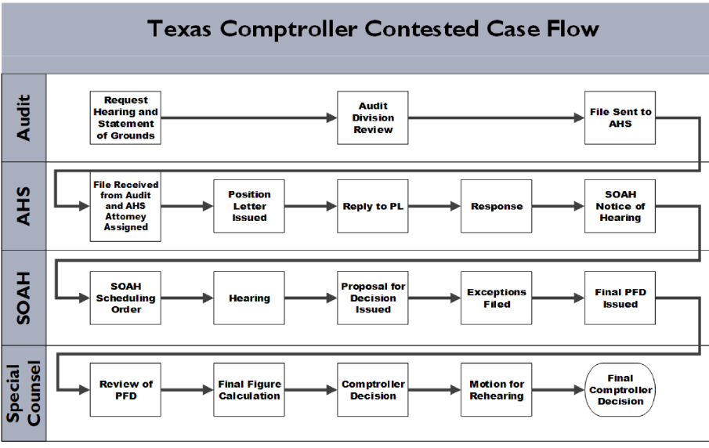

Slide 28
Redetermination
A taxpayer who disagrees with the results of an audit has several options.
A Refund Hearing Request, if the audit has been paid in full
District Court, if the audit has been paid in full
Redetermination Hearing, if the audit has not been paid in full

Slide 29
Rule 1.7
Rule 1.7 requires:
(a) The Statement of Grounds must contain the reasons the taxpayer disagrees with the action of the agency. The taxpayer must list and number the items or transactions, individually or by category, with which he disagrees. For each contested item or category of items, the taxpayer must also state the factual basis and the legal grounds to support why the taxpayer argues that the tax should not be assessed or the tax should be refunded. If the taxpayer disagrees with the agency’s interpretation of the law, specific legal authority must be cited in support of the taxpayer’s arguments.

Slide 30
Rule 1.7
(b) If an item or transaction, or category thereof, is not listed in the Statement of Grounds, it may be barred from consideration in a hearing.
(c) In the event that the taxpayer’s Statement of Grounds fails to list and number items or transactions, individually or by category, or fails to state the factual basis and legal grounds upon which relief is sought, the case may be dismissed.
(d) If a taxpayer’s Statement of Grounds raises issues that cannot be resolved from the material contained in the audit or Statement of Grounds, additional evidence may be obtained through:
(1) a preliminary conference;
(2) discovery as described in §1.33 of this title (relating to Discovery);
(3) written or oral requests for additional evidence; and
(4) an audit amendment.

Slide 31
Rule 1.7
(e) The Statement of Grounds may be amended up to the time that a reply to the Position Letter is required. All evidence on which the proving party intends to rely must be filed with the proposed amendment.
(f) This section does not apply to hearings pursuant to Tax Code, §154.1142 or §155.0592.

Slide 32
Amended Audits
Any changes to an audit after it has been completed on the computer system will result in an amended audit.

Slide 33
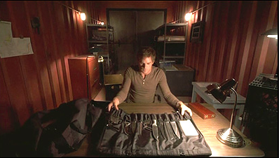
Comptroller’s Decision No. 107,496 (2013)

Slide 34
Comptroller’s Decision No. 109,162 (2014)

Slide 35
Comptroller’s Decision No. 110,666 (2017)

Slide 36
Comptroller’s Decision No. 111,757 (2015)

Slide 37
Comptroller’s Decision No. 107,342 (2015)

Slide 38
Comptroller’s Decision No. 111,071 (2015)

Slide 39
Comptroller’s Decision No. 112,817 (2016)

Slide 40
Comptroller’s Decision No. 112,817 (2016)
34 Tex. Admin. Code § 3.357(a)(8)
34 Tex. Admin. Code § 3.357(a)(11)
Op. Tex. Att’y Gen. No. MW-94 (1979)

Slide 41
Final Thoughts… What if?
If an offer is reasonable…
If the auditor does not have authority to settle…
If the case gets to Administrative Hearings…
If you refuse to settle and you and your client go to SOAH and lose…
If you lose…
If you just want to pay…
If you want to fight…

Slide 44
Questions?

Slide 45
Isreal Miller
imiller@grayreed.com

