Slide 1
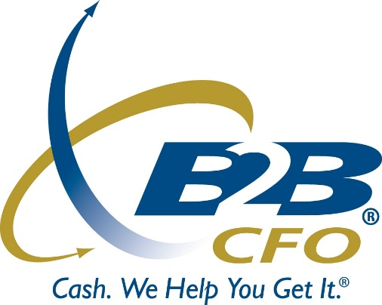
Budget, Forecast & Plan for More Profit
Loren VenHuizen
B2B CFO®
Prepared for: Construction Financial Management Association

Slide 4
Budget, Forecast & Plan for More Profit
Flying blind: Simply reviewing historical financial statements is not enough!
Taking the time to build budgets, do performance review and re-forecast the future drives better decisions.
All important decisions should be made in the context of a budgeting/forecasting meeting weighting out the pros and cons in a systematic way with real data
Successful Large Organizations make important decisions in the context of a budgeting, forecasting and planning process. Many large companies have hundreds or thousands of people directly involved in providing management with the projections.
Accounting Department > Finance Department > Decisions Makers
Operate like the Big Companies: Your team can implement these time tested methods led by your technical expertise and experience.

Slide 5
The Time Tested Process for Better Decisions
1) Budget / PR / Forecast
Organizations construct their budget at the beginning of the year and perform ongoing performance review. Rolling cash forecast process.
Performance Review w/
Budget vs. Actual Comparison
Rolling Forecast
2) Strategic Planning
Defines the vision for the future, provides the budget with high level targets. Assess risks and opportunities, yielding better strategic decisions and contingency plans.
Sensitivity/Scenario Analysis
Break-even
Business Valuation
3) External Estimate
When organizations need to demonstrate their estimated financial future to:
Lenders
Investors
Business Partners
Board of Directors
4) Big Decision Analysis
Many organizations make large investments, acquisitions, or bid on large contracts. These decisions need to be evaluated in an organized and effective way.
Quickly build intelligent financial projections

Slide 7
The Time Tested Process for Better Decisions
Build a Budget at the beginning of the year
Do Monthly Performance Review
Re-forecast the future on a rolling basis w/ cash-flow
Benefits of Budgeting:
The budget sets the direction for the business, make big decisions
Budget setting discussions unlock ways to improve performance
Targets (with incentives) for can drive improved sales or better expense/cost control
Performance Review:
Measure financial results in a comprehensive way with reports, charts, scorecards
Hold team accountable for results, reward good performance
Compare results to budget, questions past decisions
Rolling Cash Forecast:
Tactical decisions should revolve around the forecast, understand their implications
Constantly understand cash position, make moves before it is too late
Have more confidence and stability, less stress

Slide 8
The Repeating Cycle of Success
Jan
Strategic Planning Process: Typically performed in the middle of the fiscal year. Sets the direction for future
Dec
Feb
Budgeting Process: In accordance with the high level parameters set in the strategic plan
Nov
Mar
Oct
April
Performance Review: Continuously reviewing performance generally and against budgeted/ forecasted targets
Sept
May
Rolling Forecast: Accurate and tactical view of where the business is headed
Aug
June
July

Slide 10
On-Going Analysis
Good cop, bad cop
Be prepared to act as the “bad cop” and ensure continuous budgeting accountability among your employees.
Be ready on a dime
You should be able to walk into a meeting and be ready to have a discussion on the present and future of your budgeting plans at any time.
A common language
When you budget and use ratio analysis and business drivers, decisions can be made using a common language backed up by real numbers and analytics.

Slide 12
Not About Getting it “Right”
A common objection: “we cannot predict the future”
The correct response: “that doesn’t matter”
Budgeting is about creating a direction to work towards.
In the forecasting process we set a baseline. As we see that certain assumptions will not pan out, we can calculate the variance and apply that to the baseline. With this we will always have a good idea of where we stand.
Managing to a Targeted Profit
People make different decisions in order to hit their targets. The little things add up.
Example: There is a trade event coming, they can spend $2,000 at the printer they always use… or they shop it around and save $800.

Slide 13
Strategic Planning
A Long-Term Strategic Plan Serves 3 Vital Roles
1.) It sets the direction for the future that the operating budget is aligned to achieve.
2.) It is a framework for a “what-if” exercise. In an age when technology can change an industry overnight, a business must identify their largest long-term risks/opportunities and understand their estimated impact. With this info, make tactical adjustments, long-term shifts and contingency plans.
Sensitivity analysis, scenario analysis, ratios, breakeven or business valuation
3.) It serves as a personal financial review for the business owners; they can look at their business in the same way they look at their stocks and bonds (when can they retire, should they sell?).
Personal Cash Flow Analysis or business valuation

Slide 14
It is the process, not the end-product,
that adds value.
The Magic Report: Everyone is looking for a tool that will instantly produce information that will yield better decisions, unfortunately that is a fantasy.
Regular Budget/Performance Review: There is only one place to start for any business that is serious about making better decisions:
Starting the year with a line-by-line budget setting process
Monthly Performance Reviews w/ Budget vs Actual comparisons
Monthly Rolling Forecasts
Cultivating a Better Decision Making Process: Yes, of course, this will take some time, but as time goes on your business will start making better decisions.

Slide 15
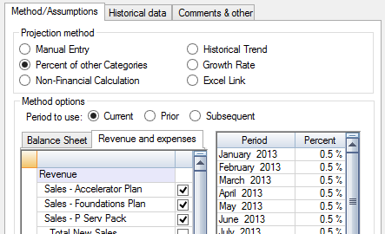
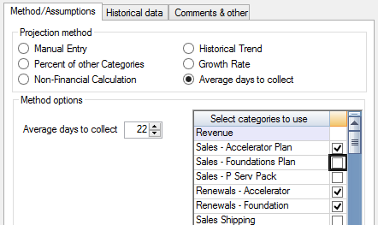
It is the process, not the end-product,
that adds value.
Line-by-line budget setting exercise
Systemically discuss all parts of the business to identify room for improvement, this will spark conversations and ideas that would never be discussed otherwise.
An IT revolution has opened up huge cost savings possibilities. We work with a number of different companies and see a wide variety of cost/expense reducing solutions.
Make targeted adjustments to businesses to reach the goals set in the budget.
Challenging decision makers to “go on the record” stimulates a deeper understanding of the business.
A series of tangible goals/targets give employees something to shoot for. Push the team to go above and beyond with financial incentives that make sense for the business.

Slide 16
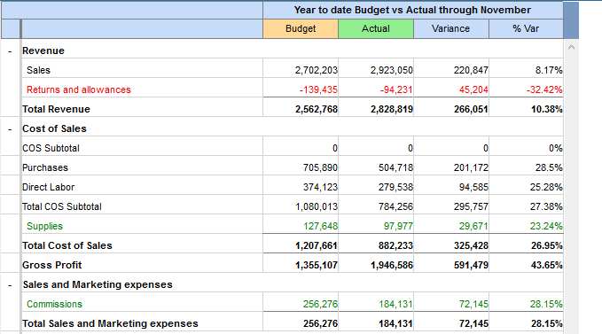
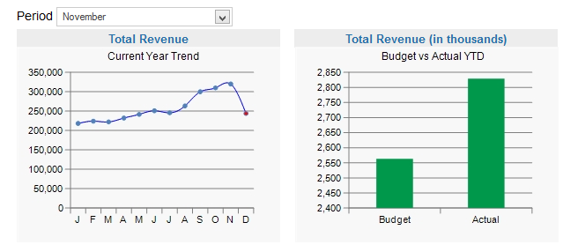
It is the process, not the end-product,
that adds value.
Monthly Performance Reviews w/ Budget vs. Actual comparisons
Comparing “what happened” to “what we thought was going to happen” can enable your team to reshape their understanding of the mechanics of the business.
When key decision makers are forced to “go on the record”, they have a greater sense of personal responsibility to figure out how to make “their number” or figure out what is truly wrong so that improvements can be made.
Team becomes Proactive not Reactive
Making more targeted adjustments to the business to reach the goals set in the budget and consider strategic changes when necessary.

Slide 17
It is the process, not the end-product,
that adds value.
Monthly Rolling Forecast
Actual results replace the budget for past months and the remaining periods are re-forecasted.
Information cultivated in the performance review will help set targets.
What assumptions were right? What assumptions were wrong?
Revise Forecasting Methods to become better over time.
Provide management team with an accurate rolling cash forecast.
Enable you to be ready for any expected cash shortfalls.
What is REALLY going to happen?
Centerpiece of the tactical decision making process

