Slide 1
Puget Sound CFMA & AGC of Washington Presents Seattle’s Construction Industry Suicide Prevention Summit
Moderator: Cal Beyers
With thanks
To Sponsors

Slide 2
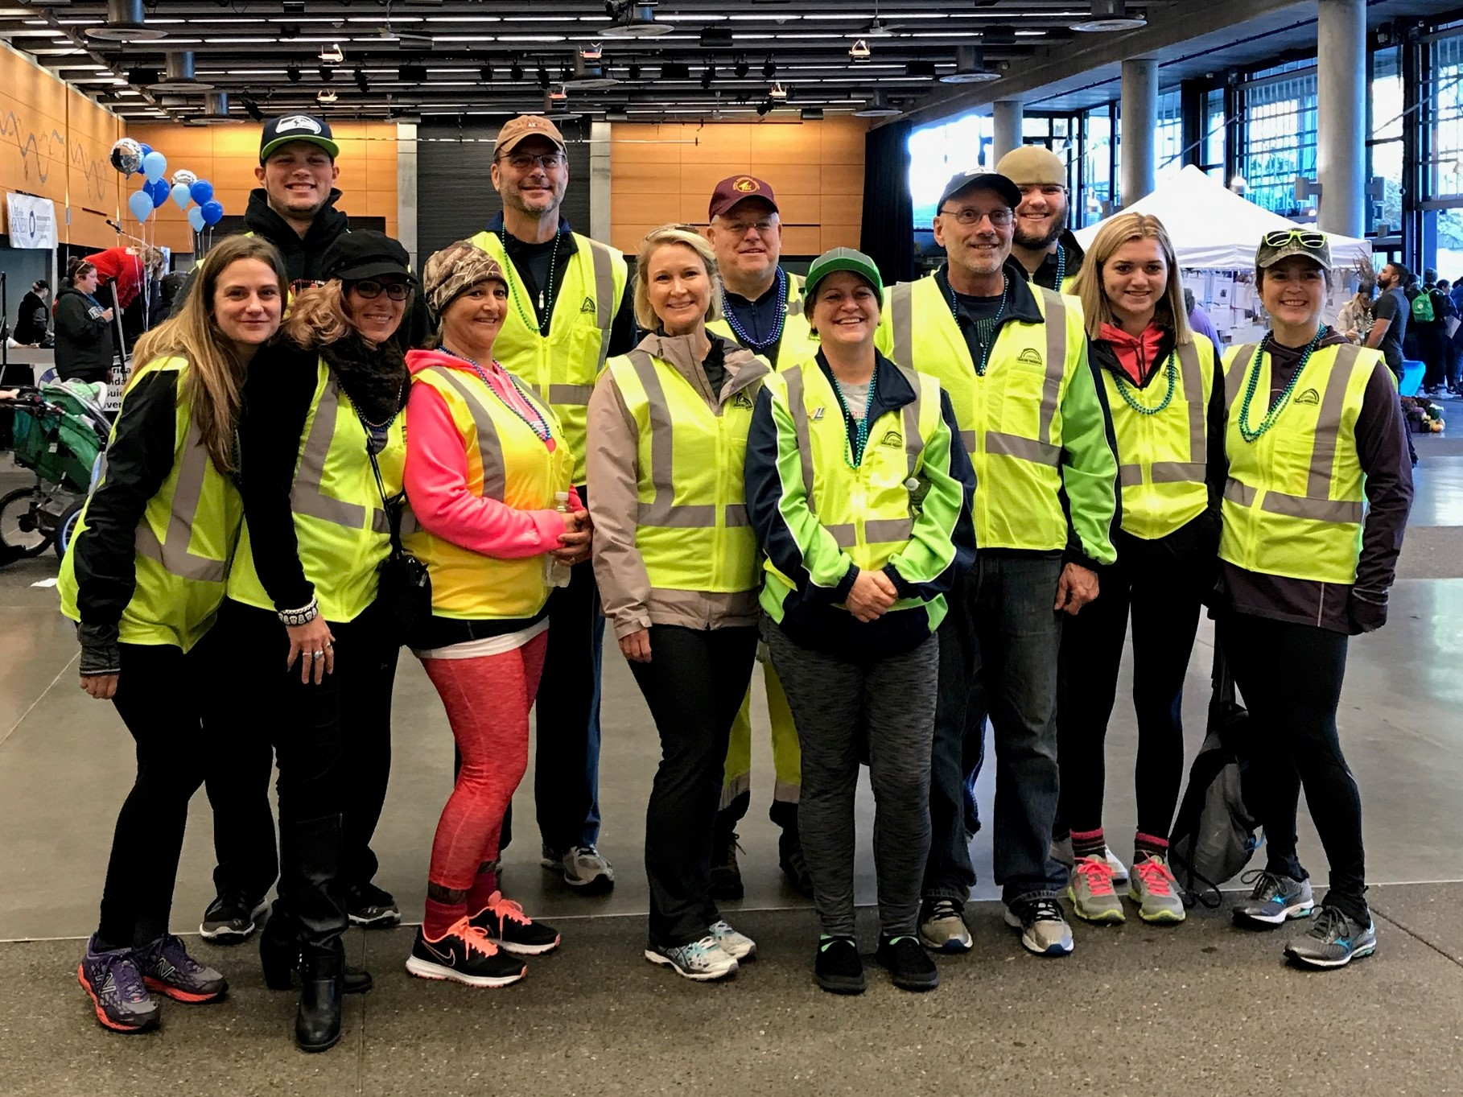
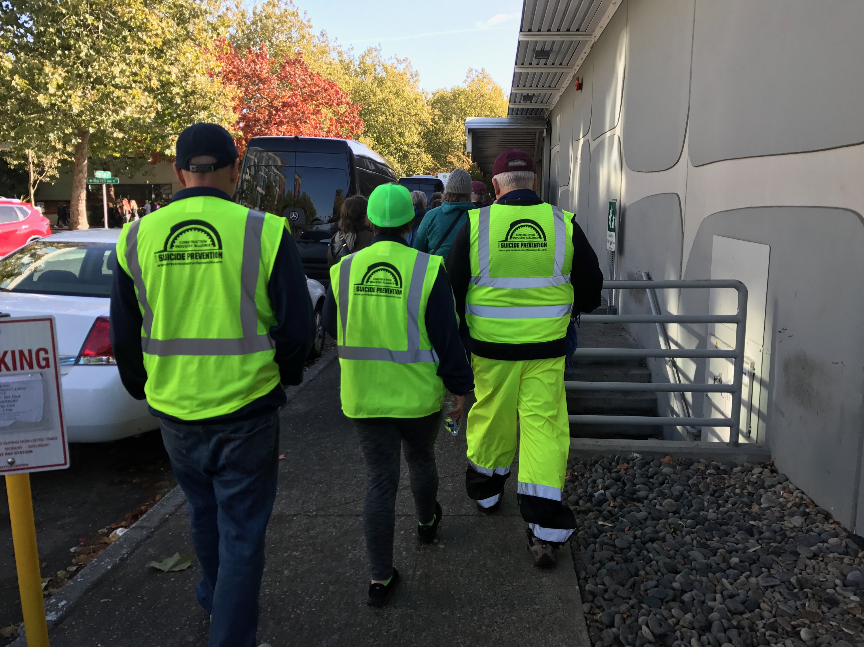
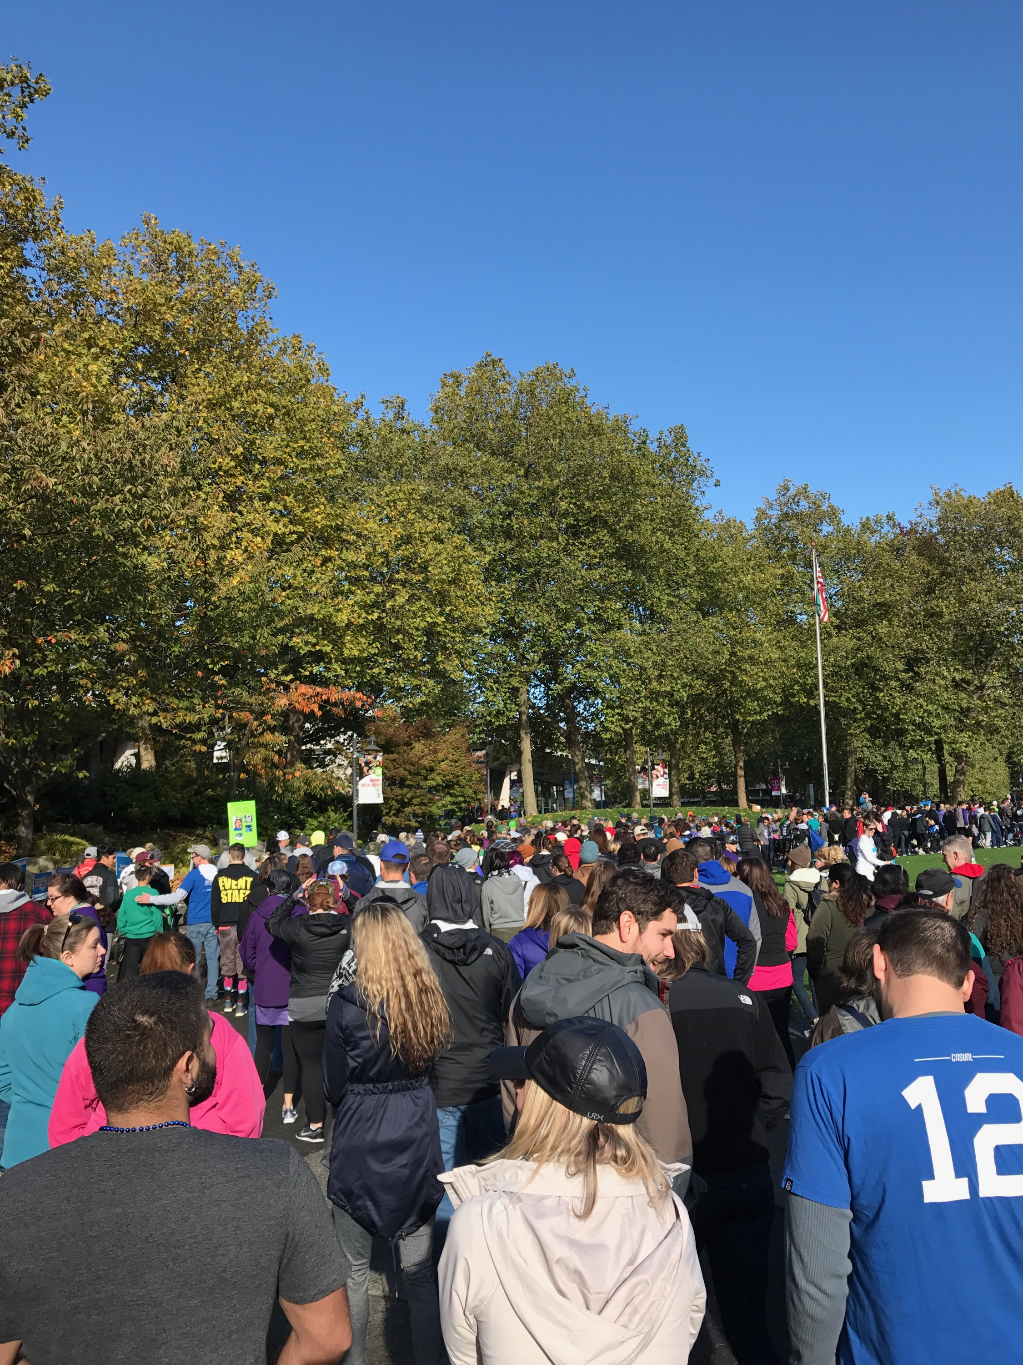
Oct 22nd Walk to Fight Suicide by Summit Leaders
Team WWW.PreventConstructionSuicide.com

Slide 3
Alliance Members

