Slide 1
Practical and Actionable Guidance for Managing Stress
October 24, 2017
Seattle's Construction Industry
Suicide Prevention Summit
Dr. Ursula Whiteside

Slide 3
Please Define
What Is Lived Experience?
Notes:
The question: What happened to you?

Slide 4
Who has Lived Experience?
People who’ve had suicidal thoughts and/or experiences

Slide 5
Number of Washington State residents who seriously considered suicide last year.
About
1 in 20
Notes:
https://headsupguys.org/22-male-athletes-speaking-depression/

Slide 6
People who report suicidal thoughts in the past two weeks when asked at a primary care appointment
About
1 in 20
Notes:
https://headsupguys.org/22-male-athletes-speaking-depression/

Slide 7
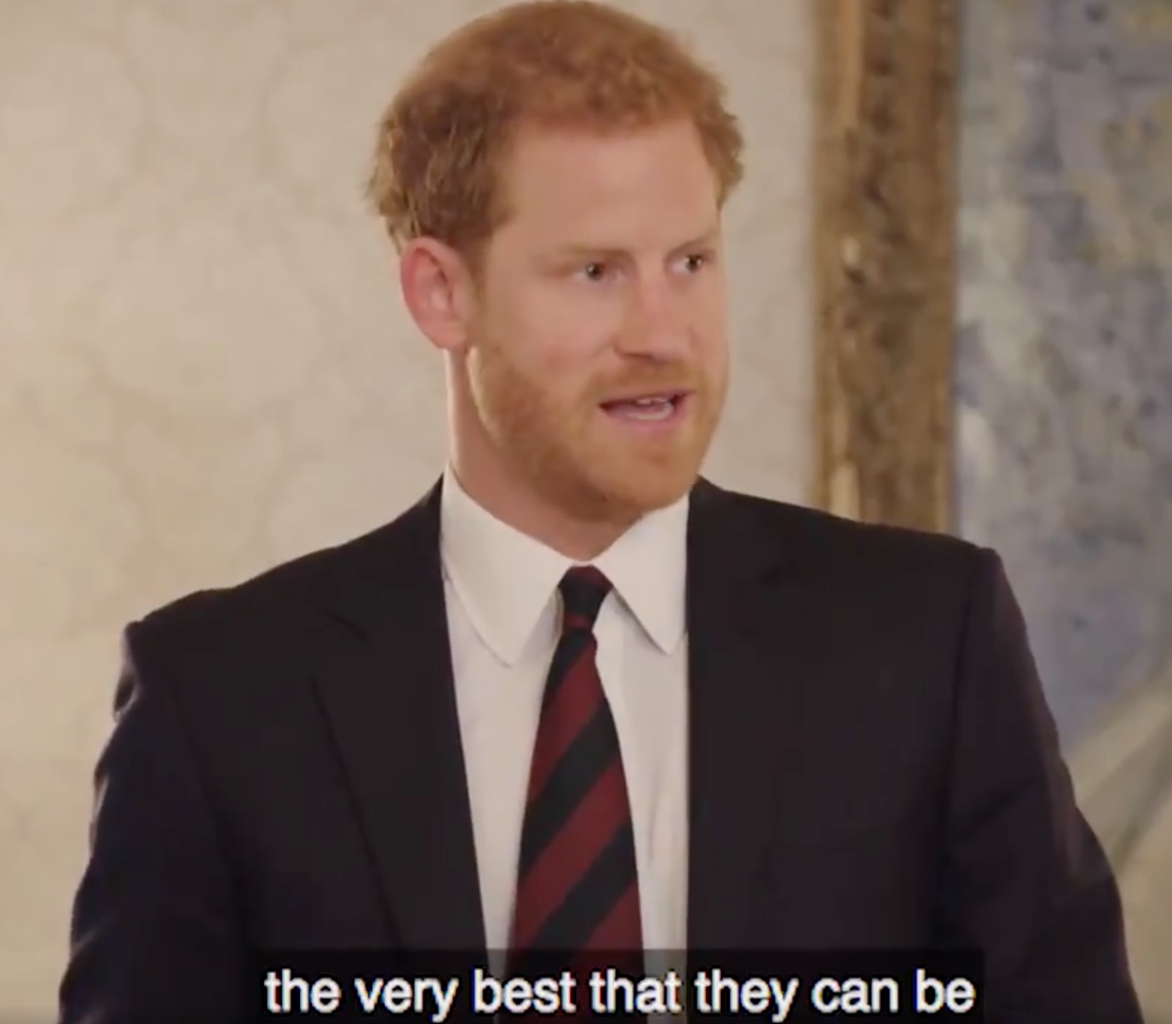
Men Stepping Up

Slide 8
Heads Up Guys
Notes:
https://headsupguys.org/22-male-athletes-speaking-depression/

Slide 9
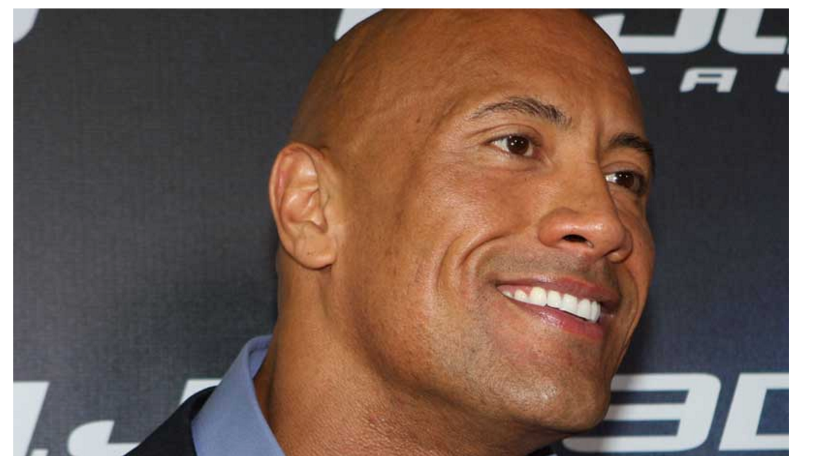
DWAYNE “THE ROCK” JOHNSON
Notes:
1. DWAYNE “THE ROCK” JOHNSON “I found that with depression one of the most important things you could realize is that you’re not alone. You’re not the first to go through it… I wish I had someone at that time who could just pull me aside and [say], ‘Hey, it’s going to be okay.'”
Actor, producer and professional wrestler, US One of the greatest professional wrestlers of all time “How a Bout of Depression Led to Dwayne Johnson’s Career Defining Moment” (Video)

Slide 10
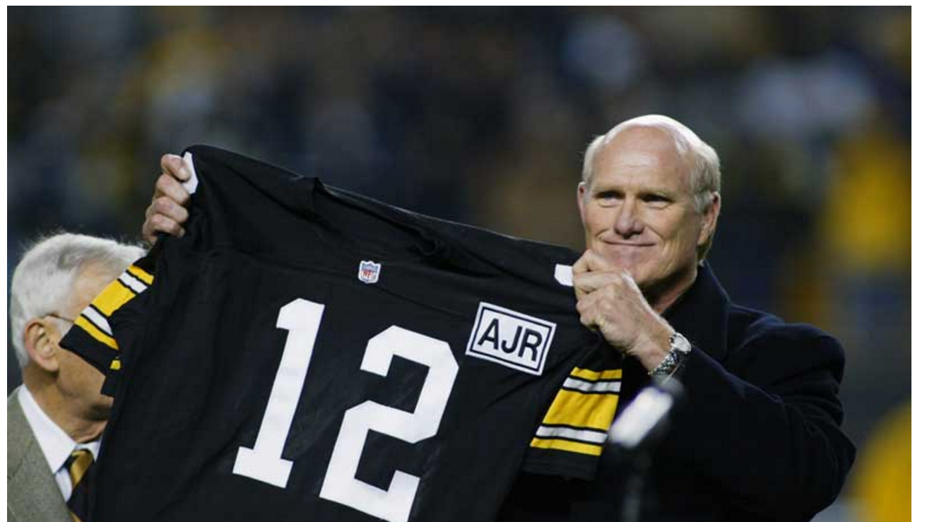
TERRY BRADSHAW
Notes:
“I thought maybe I could help people with awareness, help men get the strength and courage… I have run into people who have made fun of me, some of my colleagues. I’ve had people try to make light of it. Depression is not something you make light of. It’s serious.”
NFL quarterback and sports announcer, US 4x Super Bowl Champion, 2x Super Bowl MVP “Depression-awareness campaign aids Bradshaw too”

Slide 11
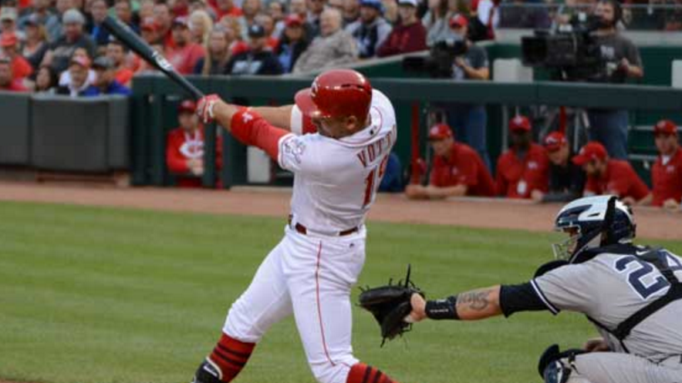
JOEY VOTTO
Notes:
“I’m seeing a couple of doctors and speaking to people and letting people know what I’m dealing with, how difficult the grieving process is.”
(On depression after the sudden passing of his father) MLB first basemen, Canada National League MVP, Canadian Athlete of the Year “Joey Votto Makes His Personal Demons Public”

Slide 12
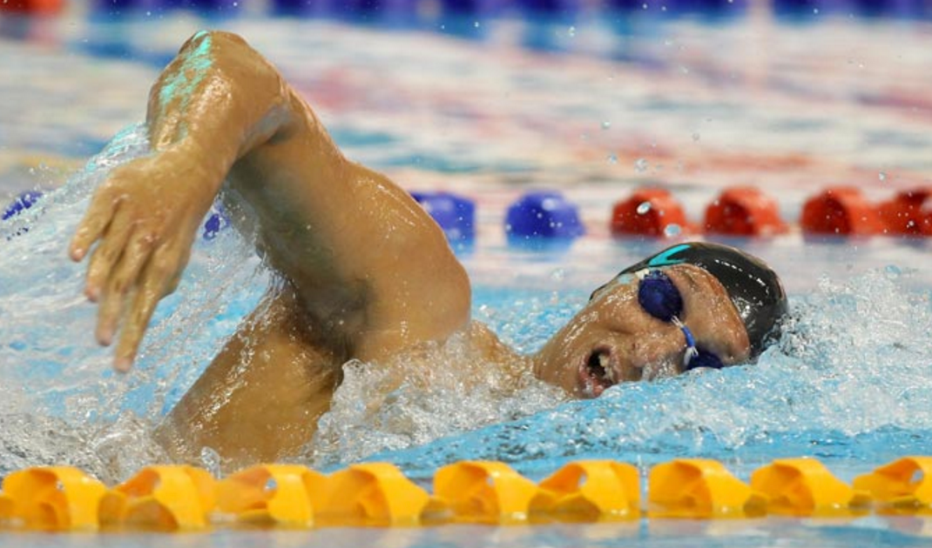
IAN THORPE
Notes:
“It’s like a weight is pressing down on you. There are days when you just can’t get out of bed. You cannot face the world. You tell yourself simple things like: ‘Just get to the kitchen and get a glass of water.’ But not being able to do something so basic is frightening.”
Swimmer, Australia 5x time Olympic Gold Medalist “Ian Thorpe: ‘I was surrounded by people but had this intense loneliness”

Slide 13
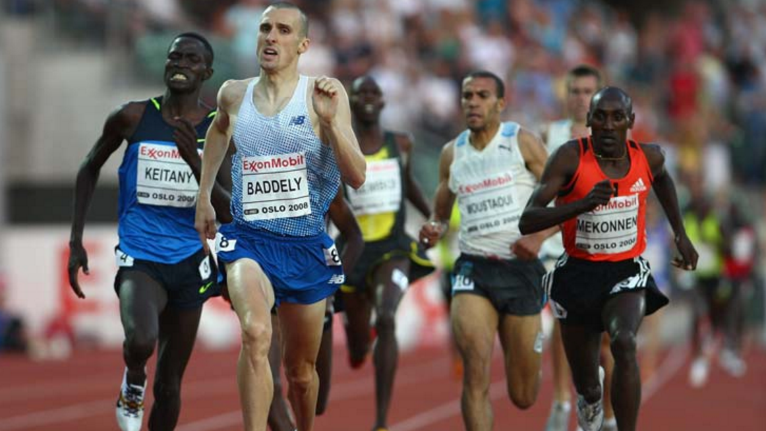
ANDY BADDELEY
Notes:
“Talking and trusting close friends continues to help. So that’s the why I am sharing this, because if anybody reads what I have written and it strikes a chord, I hope it encourages them – encourages you – to talk to someone.”
Middle-distance runner, UK Qualified for 1500m finals in Beijing 2008 Olympics “Depression: sharing my story”

Slide 14
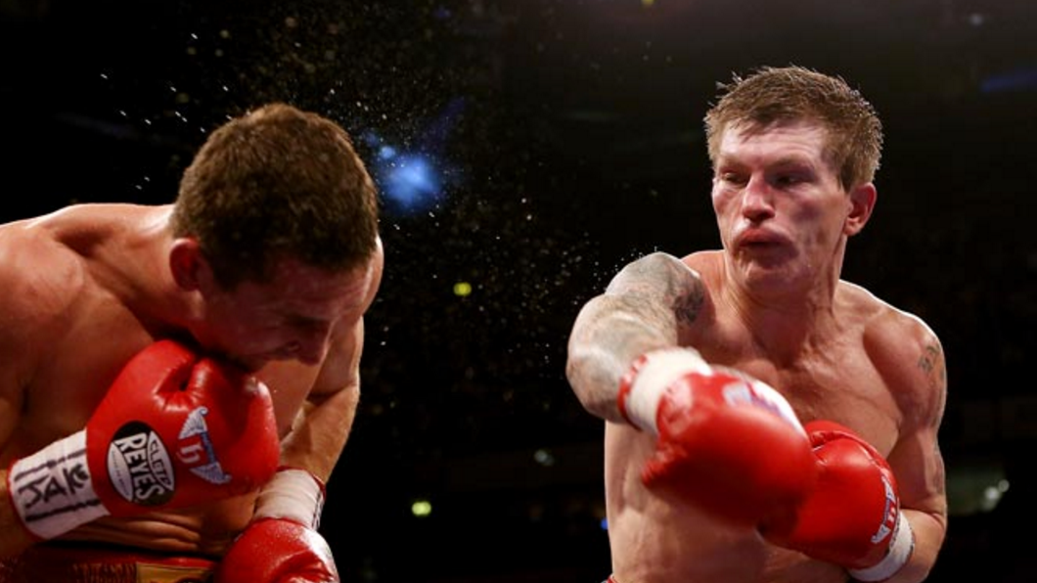
RICKY HATTON
Notes:
“We’re out of our comfort zones with depression. I certainly was and whenever I have bad days now I speak to someone to get it off my chest. I have no shame telling that and that’s why I’m here today.”
Professional boxer, UK Multiple world titles at light-welterweight, one at welterweight “Ricky Hatton: ‘I tried to kill myself several times'”
RICKY HATTON

Slide 15
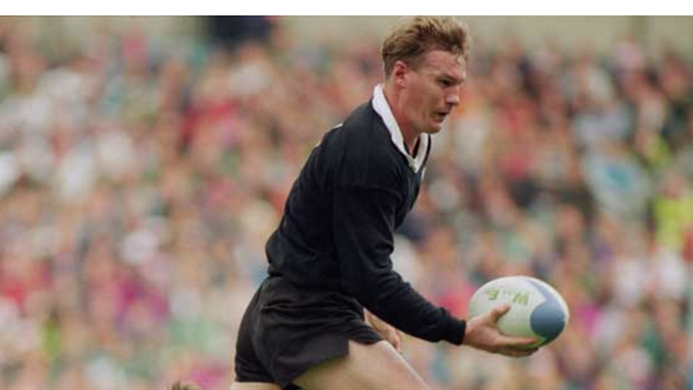
JOHN KIRWAN
Notes:
“Getting help [for depression], for someone like me who saw getting help as a weakness, was a big step. I did an awareness campaign and that first step was really difficult for me. I thought people were going to think I was mad.”
Rugby union coach and player, New Zealand One of the highest try scorers in international rugby union history “Depression: Top sports stars not immune”

Slide 16
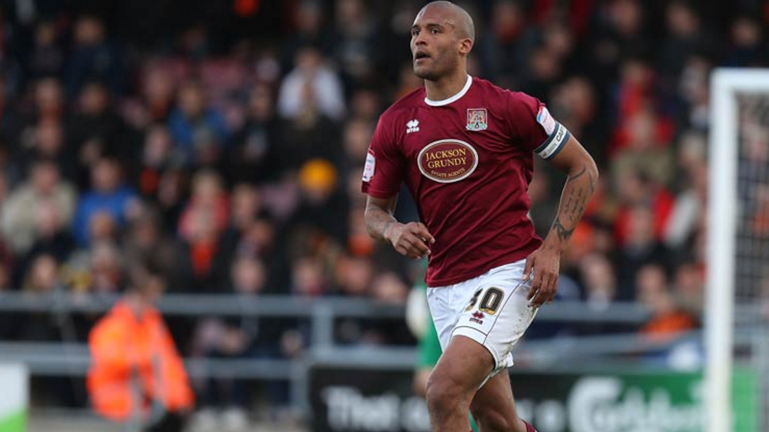
CLARKE CARLISLE
Notes:
“I wasn’t doing the things that I should have been doing to maintain my mental well-being and once you start getting into a spiral of secrecy and masking your emotions and running away then it is exactly that; you spiral down and it’s incredibly difficult to stop.”
Professional footballer, defender, UK Former Chairman of the Professional Footballers’ Association “Clarke Carlisle on Depression”

Slide 17
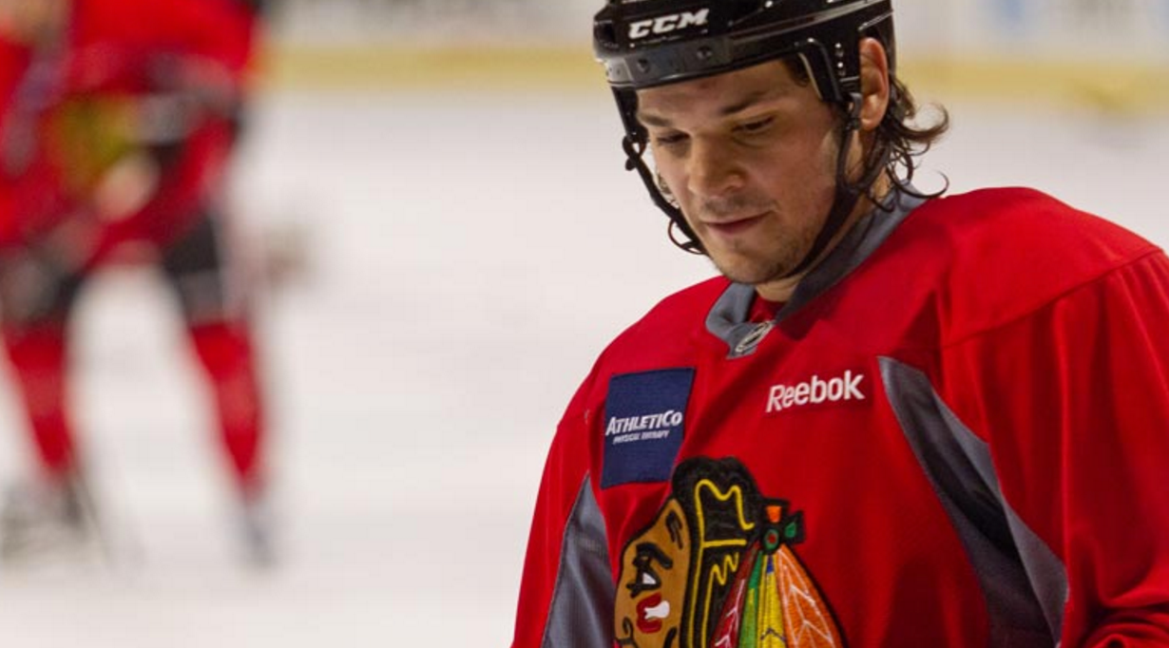
DAN CARCILLO
Notes:
“But that fall, when the new season started, I went through the same dark cycle that I witnessed firsthand with Monty [friend and teammate who died by suicide]. I went in with my eyes completely open, but I just couldn’t stop it. I started isolating myself. I felt like I didn’t have a purpose. I fell into a deep and dark depression.”
NHL left winger, Canada 2x Stanley Cup Champion “Players’Tribune: The Fourth Period”

Slide 18
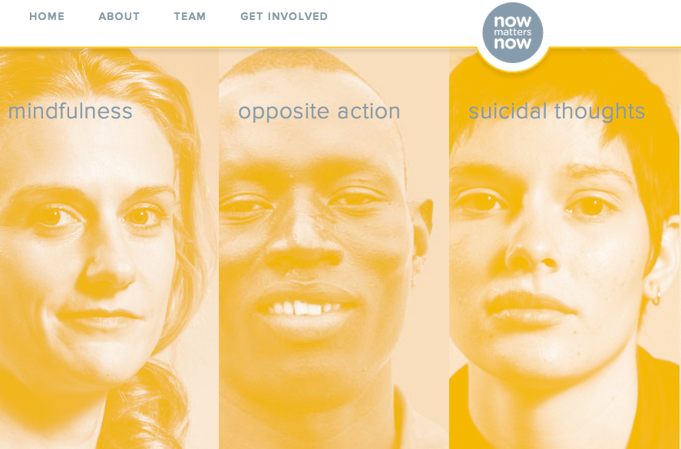
Introducing NowMattersNow.org
Notes:
Targeting Stigma, Providing Real Resources (I saw one or the other, but not both available)

Slide 19
Notes:
Watch introduction video

Slide 20
Most people don’t want to die, it’s just that they don’t how to feel better

Slide 21
Most people don’t want to die, just that they don’t how to feel better
“If you didn’t feel so (sad, depressed, hopeless) would you still be wanting to die?” “If your divorce were resolved would you still be thinking about using a gun?”

Slide 22
Suicidal thoughts by themselves are not dangerous

Slide 23
Suicidal thoughts by themselves are not dangerous
“What you do with the suicidal thought makes all the difference”

Slide 24
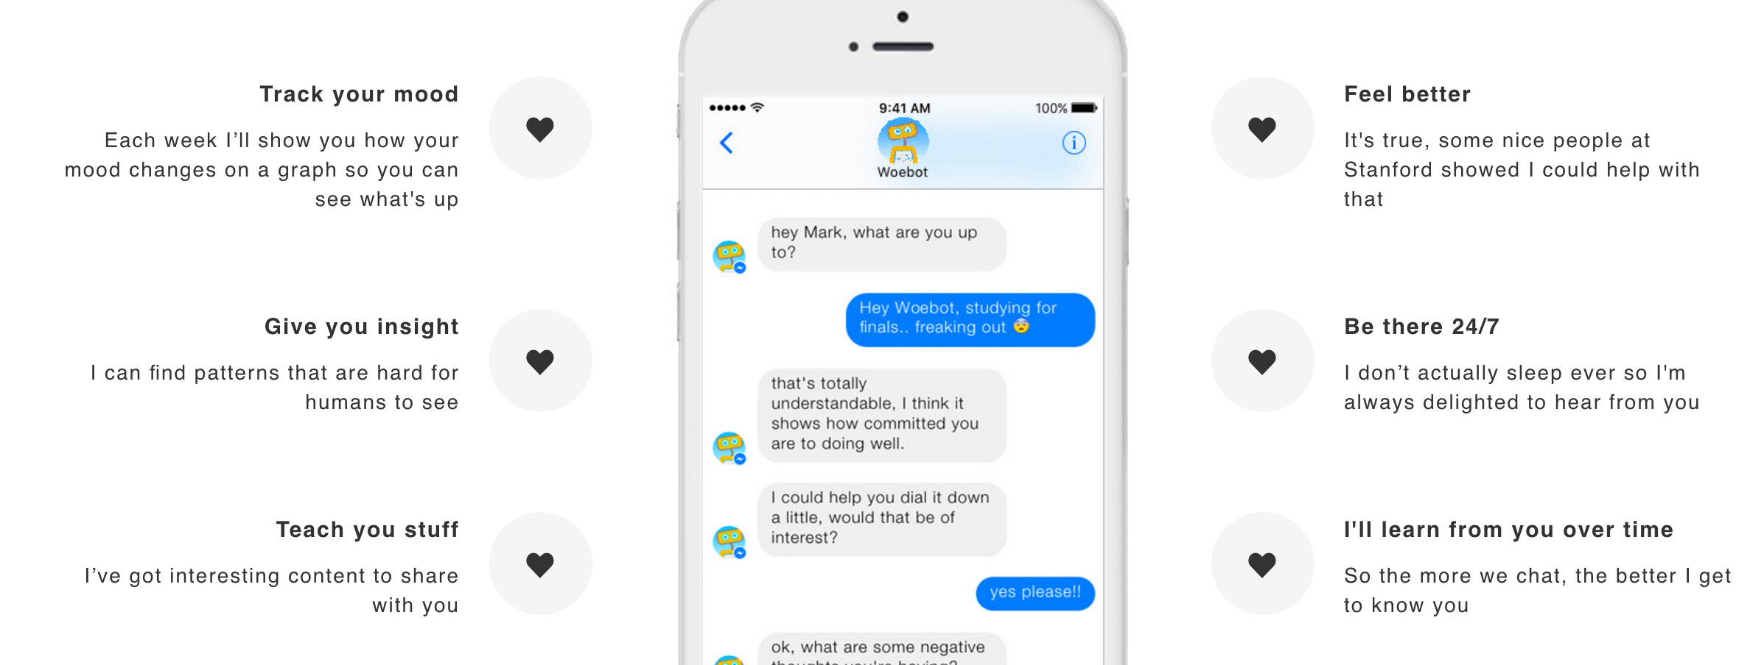
Dr. Woebot → https://woebot.io

Slide 25
Caring Messages
Care without judgment/condescension
Do not say “I’m worried about you.”
Do not ask for something
Imagine being in their shoes and what you would want to hear
Notes:
Delete or change this?
-I want to hear how it goes. Send me a message.

Slide 26
Dialectical Behavior Therapy (DBT) Skills
Motto & Bostrom, 2001
Carter et al., 2005
Vaiva et al., 2006
Fleischmann et al., 2008

Slide 27
Dialectical Behavior Therapy (DBT) Skills
Opposite Action Video
with Diana Yanez-Cortes

Slide 28
DBT Skills
Mindfulness

Slide 29
DBT Skills
Mindfulness of Current Emotion

Slide 30
DBT Skills
Paced Breathing

Slide 31
DBT Skills
Ice-Water

Slide 32
‘Do It Now’
National Suicide Prevention Lifeline
1-800-273-8255 (TALK)
Crisis Text Line
741741 “START”

