Slide 1
MENTAL HEALTH & SUICIDE PREVENTION
Presentation by: Bob Swanson
June 21, 2017

Slide 2
THE FACTS
25% of adults will experience a mental illness this year
Anxiety and depression are the two most common mental illnesses
10% of adults have an addiction to alcohol and or drugs
In 2015 more than 43,000 Americans died by suicide
Suicide is the second leading cause of death for men ages 25-54
78% of suicides are men
It is estimated that there are more than 1 million suicide attempts each year
90% of those who die by suicide have a mental illness and/or a substance abuse illness

Slide 3
WHY THE CONSTRUCTION INDUSTRY
“Old school”, “tough guy” culture
Family separation and isolation with travel
Sleep disruption/deprivation due to shiftwork
Seasonal layoffs and end of project layoffs
Chronic pain from years of hard physical labor
Access to lethal means
Construction industry has a suicide rate of 53.3 per 100,000
The rate of suicide in the Construction industry is four times that of the general population
The construction industry has more suicides than any other industry

Slide 4
THE TRUTH
Suicide IS Preventable

Slide 5
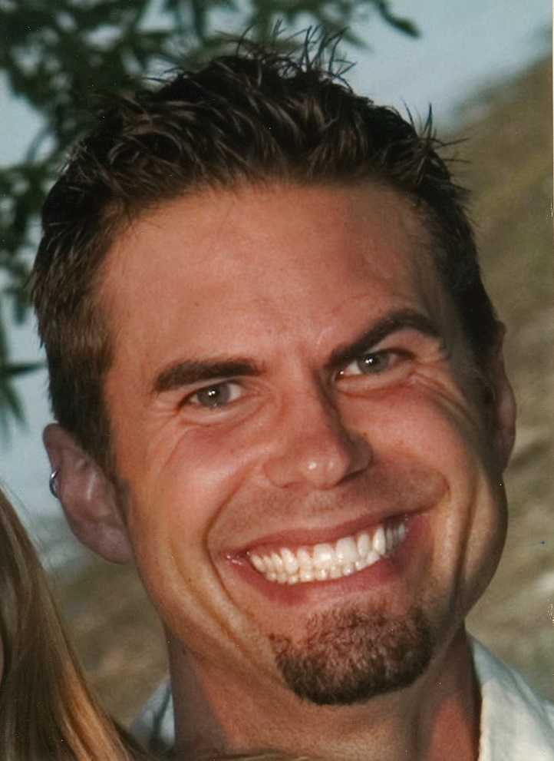
THE FACE
WHAT DO YOU SEE?
WHAT DON’T YOU SEE?

Slide 6
THE JOURNEY
Born on June 4, 1975
High School Mis-Diagnosis of Clinical Depression
Captain of High School Baseball Team
Attended Augsburg College
Head Trauma Injury at Age 23
Medication Side Effects and Self Medication
Died By Suicide on March 13, 2009 at the age of 33
Age 29 First Suicide Attempt & Diagnosis of Bipolar Disorder

Slide 7
THE ILLNESS
Mental illness is an illness of the brain
The illness is treatable

Slide 8
THE ILLNESS – THE PERSON
THE ILLNESS AND THE PERSON
ARE
SEPARATE

Slide 9
THE TRAITS
Mental Illness
More than One
Alcohol or Drugs
Shame
Decision Making
Prescribed Medication
Anger
Usually more than one illness
Regular use of alcohol or drugs
Anger
Shame
Questionable decision making
Stop the use of prescribed medication(s)
Regular routine is critical

Slide 10
THE MYTHS
Those who talk about suicide don’t do it
Don’t ask someone if they are having suicidal thoughts because it will put the idea in their head
Once a person has a suicidal plan, they cannot be stopped
People who have a suicide attempt will not attempt suicide again

Slide 11
THE CLUES
Verbal
I wish I were dead
I’m tired of life
I’m a burden to everyone
Soon you won’t have to worry about me
Behavioral
Withdrawing from family and friends
Moodiness, hopelessness and unexplained anger
Putting personal affairs in order
Giving away prized possessions
Acquiring a gun or stockpiling pills
Situational
Loss of a job
Loss of major relationship
Diagnosis of terminal illness
Loss of family member or friend by suicide
Arrest and loss of freedom

Slide 12
THE SITUATION
Talk to the person alone
Convey concern
Listen
Stay with the person
Remove any lethal means
Persuade the person to get help
Arrange for and assist the person to get help

Slide 13
WHAT NEEDS TO BE DONE
Provide information
Create a new work culture
Focus on people
Create a 24/7 health and safety program

Slide 14
MY JOURNEY OF GRIEF AND HEALING
Blame, Shame, Guilt & Anger
Role of NAMI and SAVE
Role of my faith

Slide 15
THE RESOURCES
Suicide Hotline – 1.800.273.TALK (8255)
South Dakota Helpline Center 605.334.6646 ext. 211
911 – Ask for Crisis Intervention Team (CIT)
www.constructionworkingminds.org
American Foundation For Suicide Prevention (AFSP) www.AFSP.org
National Alliance on Mental Illness (NAMI) www.NAMI.org
National Institute of Mental Health (NIMH) www.NIMH.NIG.gov
Suicide Awareness Voice of Education (SAVE) www.SAVE.org

Slide 16
questions

