Slide 1
Making safety pay
Tim McCarty, MSc, CSP, ARM, ALCM, CSSM, CPSI
Director of Loss Control Services

Slide 2
Safety Pays
$1
$3

Slide 3
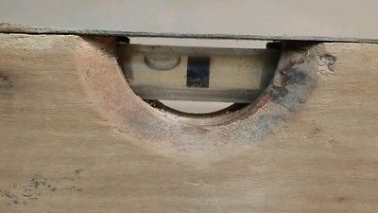
Level set
Notes:
Nothing simple about this.
A lot of assumptions, misinformation, prejudice

Slide 4
A piece of the pie

Slide 5
Cost of Safety/Compliance Efforts
Cost
Level of Safety/Compliance Effort

Slide 6
Loss Cost of Safety/Compliance Efforts
Loss Cost
Level of Safety/Compliance Effort

Slide 7
Total Cost of Safety/Compliance Efforts
Total Cost
Level of Safety/Compliance Effort

Slide 8
Total Cost of Safety/Compliance Efforts
Total Cost
Level of Safety/Compliance Effort

Slide 9
Sphere of interest
OSHA

Slide 10
Spheres of interest
DOT
OSHA

Slide 11
Spheres of interest
DOT
OSHA
MSHA

Slide 12
Spheres of interest
DOT
OSHA
Injury/Loss
Prevention
MSHA

Slide 13
Spheres of interest
DOT
OSHA
Injury/Loss
Prevention
Insurance
Company
MSHA

Slide 14
Spheres of interest
DOT
OSHA
Injury/Loss
Prevention
Insurance
Company
MSHA

Slide 15
Spheres of interest
DOT
OSHA
Injury/Loss
Prevention
Insurance
Company
MSHA

Slide 16
Spheres of interest
DOT
OSHA
Injury/Loss
Prevention
Insurance
Company
MSHA

Slide 17
Thank you
Tim McCarty, MSc, CSP, ARM, ALCM, CPSI, CSSM
Director of Loss Control Services
Clark Insurance
PO BOX 3543
Portland, ME 04104
T: 207.523.2204
C: 207.747.8591
tmccarty@clarkinsurance.com

