Slide 1
Massachusetts CFMA Accounting Update
October 8, 2013

Slide 2
Agenda
Background/Standard Setting Environment
AICPA’s FRF for SMEs
FASB’s Private Company Council Proposals
FASB/IASB Joint Projects
Questions

Slide 3
Background/Standard Setting Environment
Financial Accounting Standards Board (FASB) and International Accounting Standards Board (IASB) are making efforts to converge accounting standards
Key convergence projects have arisen from these efforts including:
Lease project
Revenue recognition
SEC has yet to make decision regarding use of International Financial Reporting Standards (IFRS)
Financial Accounting Foundation establishes Private Company Council in May 2012
AICPA releases FRF for SMEs in June 2013

Slide 4
AICPA’s FRF for SMEs
Accounting Developments

Slide 5
AICPA’s FRF for SMEs
AICPA issued their Financial Reporting Framework for Small- and Medium-Sized Entities in June 2013
Special-purpose framework
Other comprehensive basis of accounting (OCBOA)
Application is purely optional
Designed for use by small- and medium-sized entities that are not required to provide financial statements prepared in accordance with U.S. GAAP
However, small- and medium-sized is not defined
NASBA and AICPA will work together to develop a decision-making tool and illustrative examples related to when the FRF for SMEs is a suitable framework to apply

Slide 6
AICPA’s FRF for SMEs
Principles-based framework
Measurement basis
Primarily uses historical cost
Some use of market value (which is not necessarily the same as ASC 820 fair value)
Includes principles and guidance comparable to guidance in:
CICA Handbook published by The Canadian Institute of Chartered Accountants
U.S. GAAP
IFRS for SMEs
Income tax basis of accounting
Cash basis of accounting

Slide 7
AICPA’s FRF for SMEs
Examples of significant differences between FRF for SMEs and U.S. GAAP
 | FRF for SMEs | U.S. GAAP
Intangible assets | All have finite useful lives and are amortized | Some are indefinite-lived and not amortized
Internally-generated intangible assets | Choose between expensing or capitalizing costs incurred during development phase if certain criteria are met | Expense costs associated with internally-generated intangible assets
Intangible assets acquired in a business combination | Choose to either separately recognize intangible assets or subsume into goodwill | Identifiable intangible assets must be recognized separate from goodwill
Related PCC proposal pending

Slide 8
AICPA’s FRF for SMEs
Examples of significant differences between FRF for SMEs and U.S. GAAP
 | FRF for SMEs | U.S. GAAP
Goodwill | If amortized for tax, use tax life, otherwise amortize over 15 years | Not amortized
Impairment of long-lived assets | Long-lived assets are depreciated or amortized and are not tested for impairment | Comprehensive impairment models provided for various types of long-lived assets
Derivatives | Cash basis and no hedge accounting | Provides comprehensive accounting model
Related PCC proposal pending

Slide 9
AICPA’s FRF for SMEs
Examples of significant differences between FRF for SMEs and U.S. GAAP
 | FRF for SMEs | U.S. GAAP
Investments in joint ventures | Choose between the equity method and proportionate consolidation | Account for using equity method if significant influence exists
NCI in business combination | Measure at proportionate share of acquiree’s identifiable net assets as of the acquisition date | Measure at FV
Consolidation | Choose to consolidate based on control or use equity method | Consolidation model based primarily on control
Variable interest entities | Does not incorporate concept | Provides comprehensive consolidation guidance
Related PCC proposal pending

Slide 10
AICPA’s FRF for SMEs
Examples of significant differences between FRF for SMEs and U.S. GAAP
 | FRF for SMEs | U.S. GAAP
Income taxes | Choose between a taxes payable method and deferred income taxes method | Comprehensive deferred income tax accounting model is provided
Uncertain tax positions | Does not incorporate concept | Provides specific accounting model
Comprehensive income | Does not incorporate concept | Incorporates concept

Slide 11
AICPA’s FRF for SMEs
Examples of significant differences between FRF for SMEs and U.S. GAAP
 | FRF for SMEs | U.S. GAAP
Stock-based compensation | Disclosure only | Provides comprehensive accounting model
Defined benefit plans | Choose between current contribution payable method or one of two accrued benefit obligation methods | Requires use of a projected benefit obligation method

Slide 12
AICPA’s FRF for SMEs
Transition: Apply the FRF for SMEs to the opening balance sheet
Retrospective application
Exemptions related to the following are provided:
Business combinations
Financial assets and liabilities
Asset retirement obligations
Prohibited from retrospective application of certain principles related to the following:
Derecognition of financial assets and financial liabilities
Estimates
Noncontrolling interests

Slide 13
Private Company Council Developments

Slide 14
Private Company Council (PCC)
PCC previously issued 4 proposals which provide alternatives for private companies
Business combinations
Goodwill*
Interest rate swaps*
Consolidation of Variable Interest Entities
*Approved by PCC for submittal to FASB for endorsement
Notes:
The proposed amendments would permit a private company to elect not to apply VIE guidance for assessing whether it should consolidate a lessor entity when (1) the lessor entity and the private company are under common control, (2) the private company has a leasing arrangement with the lessor entity, and (3) substantially all of the activity between the two entities is related to the leasing activity of the lessor entity.
The accounting alternative, when elected, would be an accounting policy election that would be applied by a private company to all current and future lessor entities under common control that meet the criteria for applying this approach.
If a private company lessee elects to apply the guidance in this proposed Update, it would be required to disclose additional information about each applicable lessor entity. Such disclosures would include the key terms of the leasing arrangements, the amount of debt and/or significant liabilities of the lessor entity under common control, the key terms of existing debt agreements of the lessor entity under common control, and the key terms of any other explicit interest related to the lessor entity under common control. In addition, entities that elect this alternative should continue to apply other applicable Codification guidance, including Topic 840, Leases, and Topic 460, Guarantees.

Slide 15
Private Company Council (PCC)
Business combinations
Recognize only intangible assets that arise from noncancelable contractual terms or other legal rights
Goodwill
Amortize goodwill over the lesser of: (a) the useful life of the primary asset acquired in the business combination that gave rise to the goodwill and (b) 10 years
Test goodwill for impairment at the entity level and determine goodwill impairment by comparing the fair value of the entity to its carrying amount
Test goodwill for impairment only when a triggering event occurs

Slide 16
Private Company Council (PCC)
Interest rate swaps
Choose between two simpler approaches to account for certain interest rate swaps focused on converting variable-rate debt to fixed-rate debt
The income statement impact of both approaches would be similar to the impact if the entity had instead entered into fixed-rate debt (Not available to financial institutions)

Slide 17
Private Company Council (PCC) VIE Alternative
A private company may elect not to apply the VIE model in assessing whether to consolidate a legal entity if:
the legal entity and the private company are under common control,
the private company has a leasing arrangement with the legal entity, and
substantially all of the activities between the two entities relate to the leasing activity

Slide 18
Major joint projects
Accounting developments

Slide 19
Major joint projects timeline
 |  | 2013 |  | 2014
Project | Status | 3Q | 4Q | 1H
Revenue recognition | Final ASU expected |  | F
Leases | ED issued in May 2013 | C,R | R
Financial instruments
Recognition and measurement | ED issued in Feb 2013 |  |  | F
Impairment | ED issued in Dec 2012
Hedging | DP issued in Feb 2011
Insurance | ED issued in June 2013 |  | C
C = Comment deadline DP = Discussion paper ED = Exposure draft F = Final R= Roundtables

Slide 20
Revenue recognition
Why should you be interested? | Revenue recognition policies of almost all entities will be effected Virtually all industry-specific guidance will be superseded
What’s the status? | Final ASU expected in Q4 2013
What’s happened recently? | Drafting final standard Discussions related to collectibility, licenses and the constraint
When would it be effective? | 2017 for calendar year-end public companies 2018 for calendar year-end private companies

Slide 21
Leases
Why should you be interested? | Accounting by lessees and lessors could change drastically
What’s the status? | Revised ED issued in May 2013 Comment letters due in September 2013 Roundtables held in Q3 and Q4 2013
What themes have come through in comment letters and round tables? | Generally not supportive of model in revised ED Differing opinions on how to move forward Do away with Type A/B model Disclosure only standard Feedback to FASB and IASB is (not) consistent
What’s next? | Redeliberations

Slide 22
Timeline – Lease Project
August 2010—Exposure Draft
December 2010—Comment letters due
January 2011—Commencement of redeliberations
May 2013—Revised Exposure Draft
September 2013—Comment letters due
2014(?)—Final Accounting Standards Update
2017-2018(?)—Effective date

Slide 23
Lease Classification
Is the lessee expected to consume more than an insignificant portion of the economic benefits embedded in the underlying asset?
Yes: Type A lease
No: Type B lease

Slide 24
Lease Classification—Practical Expedient
If the lease is not a lease of property, classify as Type A unless one or both of following are met:
Lease term is for an insignificant part of the total economic life of underlying asset;
Present value (PV) of lease payments is insignificant compared to fair value (FV) of underlying asset
If the lease is a lease of property, classify as Type B unless one or both of following are met:
The lease term is for the major part of the remaining economic life of the underlying asset;
PV of lease payments accounts for substantially all of the FV of the underlying asset
Effect of purchase options

Slide 25
Lessee Accounting—Type A Lease
Record right-of-use (ROU) asset and lease liability, initially measured at PV of lease payments
Consider lease term, termination penalties, purchase options, lease incentives, residual value (RV) guarantees, certain variable lease payments, discount rate, etc.
Liability is accreted based on effective interest method
ROU asset is amortized
Interest and amortization expense are presented separately
For Type A leases, lease costs will be greater in the early periods of the lease term compared to later periods (i.e., “front loading” expenses)

Slide 26
Lessee Accounting—Type B Lease
Record ROU asset and lease liability, initially measured at PV of lease payments
Liability is accreted based on effective interest method
ROU asset reduced by the difference between (a) accretion of the liability and (b) periodic straight-line expense
Present total lease expense as a single amount

Slide 27
Lessor Accounting
Same Type A/Type B determination
Type A: “Receivable and Residual Approach”
Derecognize underlying asset
Record a lease receivable and a residual asset
Variable payments and residual value guarantees
Recognize profit on asset derecognized
Recognize interest income on receivable and residual asset
Type B: “Straight Line”
Retain underlying asset on balance sheet
Recognize lease income over lease term on a straight-line basis unless another method is more representative of how income is earned

Slide 28
Example
Lessor and Lessee enter into a lease with a three-year term
Annual lease payments are made in arrears in the amount of $11,500 and the discount rate is 7.327%
The amortization period for the right-of-use asset is three years
Using this information, the present value of the lease payments is $30,000
Fair value and carrying amount of asset at commencement date are $38,000 and $24,000, respectively
Expected value at the end of the lease term is $10,000
The following slides illustrate and compare Lessee’s and Lessor’s accounting for the lease as a Type A lease and a Type B lease.
For ease of illustration, the lease does not include any options to extend or terminate the lease or initial direct costs

Slide 29
Lessee Example
TYPE A
Year | Payment | Ending ROU Asset Balance | Ending Liability Balance | Principal | Interest | Amortization | Total Expense
0 |  | $30,000 | $30,000
1 | $11,500 | 20,000 | 20,698 | $9,302 | $2,198 | $10,000 | $12,198
2 | 11,500 | 10,000 | 10,715 | 9,983 | 1,517 | 10,000 | 11,517
3 | 11,500 | -- | -- | 10,715 | 785 | 10,000 | 10,785
TYPE B
Year | Payment | Ending ROU Asset Balance | Ending Liability Balance | Principal | Interest | Amortization | Total Expense (1)
0 |  | $30,000 | $30,000
1 | $11,500 | 20,698 | 20,698 | $9,302 | $2,198 | $9,302 | $11,500
2 | 11,500 | 10,715 | 10,715 | 9,983 | 1,517 | 9,983 | 11,500
3 | 11,500 | -- | -- | 10,715 | 785 | 10,715 | 11,500
Note 1: Certain amounts shown for demonstrative purposes only. Lessees should recognize one total lease expense as an operating expense.

Slide 30
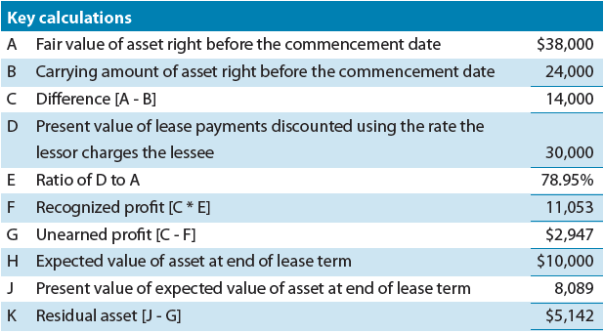
Lessor Example – Type A

Slide 31
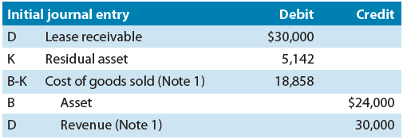
Lessor Example – Type A
Note 1: Whether revenue and cost of goods sold would be presented gross or net in the income statement depends on the lessor’s business model.

Slide 32
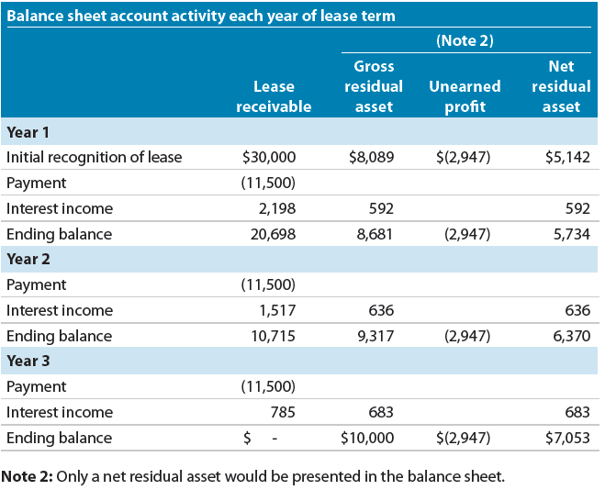
Lessor Example – Type A

Slide 33
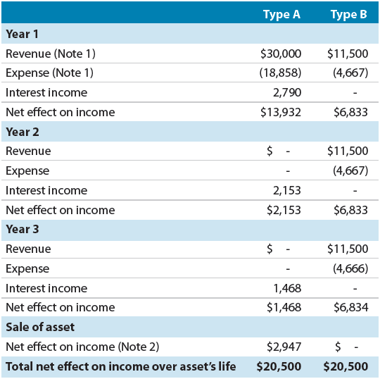
Lessor Example – Comparison of Type A and Type B
Note 1: Whether revenue and cost of goods sold would be presented gross or net in the income statement depends on the lessor’s business model.
Note 2: Assume Lessor sells the asset to Third Party for $10,000 immediately after the end of the lease term.

Slide 34
Lessee Presentation
Balance Sheet
ROU asset classified based on how the underlying asset would be classified, if owned
Separate presentation (or disclosure) of ROU assets and lease liabilities by type of lease (Type A and Type B)
Income Statement
For Type A leases, present amortization and interest expense separately from other amortization and interest expense
For Type B leases, present a combined lease expense

Slide 35
Lessor Presentation
Balance Sheet
Type A leases—derecognize underlying asset and record lease receivable and residual asset
Type B leases—underlying asset remains on balance sheet
Income Statement
Type A leases—Recognize profit on asset derecognized, and recognize income on receivable and residual asset
Type B leases—recognize income straight-line over lease term

Slide 36
Lessee Disclosures
Numerous new disclosure requirements. At a minimum, lessees would have to disclose the following to meet the overall objective:
Information about the nature of its leases and subleases (e.g., general description, terms of variable lease payments), including significant leases for which the commencement date is in the future
Information about significant assumptions and judgments made when accounting for its leases (e.g., whether a lease exists, allocation of contract consideration, discount rate)
For lessees that are public entities, a reconciliation of the opening and closing balances of lease liabilities separately for both Type A and Type B leases, which must include specific reconciling items, such as new liabilities related to new leases, the unwinding of the discount and cash payments
Recognized costs associated with variable lease payments that were not included in the lease liability
Future cash flows reflected in the lease liability on an undiscounted and annual basis for at least five years and the total thereafter with a reconciliation of the total future cash flows to the lease liability reflected on the balance sheet
Future cash flow commitments for non-lease components on an undiscounted and annual basis for at least five years and the total thereafter
Information about related-party leases
In addition, lessees would disclose the acquisition of right-of-use assets by incurring lease liabilities as a non-cash transaction

Slide 37
Lessor Disclosures
For all leases:
Information about the nature of the leases (e.g., general description, terms of options to extend or terminate)
Information about significant assumptions and judgments made when accounting for its leases (e.g., whether a lease exists, allocation of contract consideration)
Information about related party leases
For Type A leases:
Separate reconciliations of the opening and closing balances of the lease receivable and residual asset, which must include specific reconciling items, such as additions related to new leases and impairments
A table of all lease-related income by specific type of income, such as profit recognized on the commencement date and the unwinding of the discount separately for the lease receivable and residual asset
Future cash flows reflected in the lease receivable on an undiscounted and annual basis for at least five years and the total thereafter with a reconciliation of the total future cash flows to the lease receivable reflected on the balance sheet
Information about how the risks associated with residual assets are managed, including information about residual value guarantees and other risk mitigation techniques (e.g., buyback agreements)
For Type B leases:
Lease income split between those amounts included in lease payments and those amounts that were not (e.g., variable lease payments based on something other than an index or rate)
Undiscounted future lease payments on an annual basis for at least five years and the total thereafter

Slide 38
Transition
Option to apply full retrospective or modified retrospective approach
Modified retrospective approach provides for some transitional relief

Slide 39
Revenue recognition
Joint project between the FASB and IASB
Objective: Develop a single revenue recognition model that would replace all (or most) current U.S. GAAP and IFRS revenue recognition guidance
Boards discussed this project as recently as July 25
Final standard expected in late September 2013
The information in this presentation is based on our understanding of the FASB and IASB decisions to date and our expectations of what will be in the final standard when published. The information in the final standard could be different from that being presented today.

Slide 40
Core principle
Recognize revenue to depict the transfer of promised goods or services to customers in an amount that reflects the consideration to which the entity expects to be entitled in exchange for those goods or services

Slide 41
Scope
Applies to all contracts with customers except those for:
Financial instruments
Guarantees other than warranties
Insurance
Leases
Certain nonmonetary exchanges
SIGNIFICANT CHANGE: Vast majority of industry-specific guidance will be superseded.

Slide 42
Scope
Recognition and measurement principles apply to sales of nonfinancial assets that are not classified as revenue
Sale of a business to a customer
SIGNIFICANT CHANGE: Revenue recognition and measurement principles will apply to certain transactions that generate gains instead of revenue.

Slide 43
Five-step revenue model
Identify the contract with a customer
Identify the separate performance obligations in the contract
Determine the transaction price
Allocate the transaction price to the separate performance obligations
Recognize revenue when (or as) each performance obligation is satisfied

Slide 44
Identify the contract with a customer
Contract
Several factors will have to be considered in determining whether an arrangement is a contract for purposes of the standard
One of those factors will be whether there is a commitment by both parties to perform
Link to collectibility → Significant risk about customer’s ability to pay?
SIGNIFICANT CHANGE: How collectibility is considered in the context of revenue recognition will change.

Slide 45
Identify separate performance obligations
Performance obligation
Promise in a contract to transfer a good or service
Includes both explicit and implicit goods or services
Excludes activities that do not transfer a good or service
Set-up activities
Activation activities

Slide 46
Identify separate performance obligations
Account for a good or service separately if it is both:
Capable of being distinct because the customer can benefit from the good or service on its own or together with other resources readily available to the customer
Distinct within the context of the contract because the good or service is not highly dependent on, or highly interrelated with, other promised goods or services in the contract
SIGNIFICANT CHANGE: The guidance on separating performance obligations will be different from the current industry-specific multiple-element arrangement models.

Slide 47
Experience the power of being understood.SM
About McGladrey
McGladrey LLP is the leading U.S. provider of assurance, tax and consulting services focused on the middle market, with more than 6,500 professionals and associates in 75 offices nationwide. McGladrey is a licensed CPA firm, and is a member of RSM International, the sixth largest global network of independent accounting, tax and consulting firms.
We provide the following services through our practice areas:
Assurance
Tax
Consulting
Wealth Management
International Business
Follow us on:

