Slide 1
AI In Construction
NW Ohio cfma presentation
January 21, 2021

Slide 2
What Is AI
Artificial intelligence enables computers and machines to mimic the perception, learning, problem-solving, and decision-making capabilities of the human mind.
-IBM

Slide 3
What Is AI
learning from examples and experience
recognizing objects understanding
responding to language
making decisions, solving problems
combining these and other capabilities to perform functions a human might perform, such as greeting a hotel guest or driving a car.

Slide 4
AI IN DAILY Lives
Endless
Feed
Product Recommendations
Song
Recommendations
Route
Recommendations
Smart
Replies

Slide 5
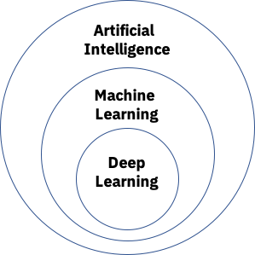
TYPES OF AI
IBM
IBM

Slide 6
Boston dynamics
***DOWNLOAD AND ADD VIDEO HERE*****

Slide 7
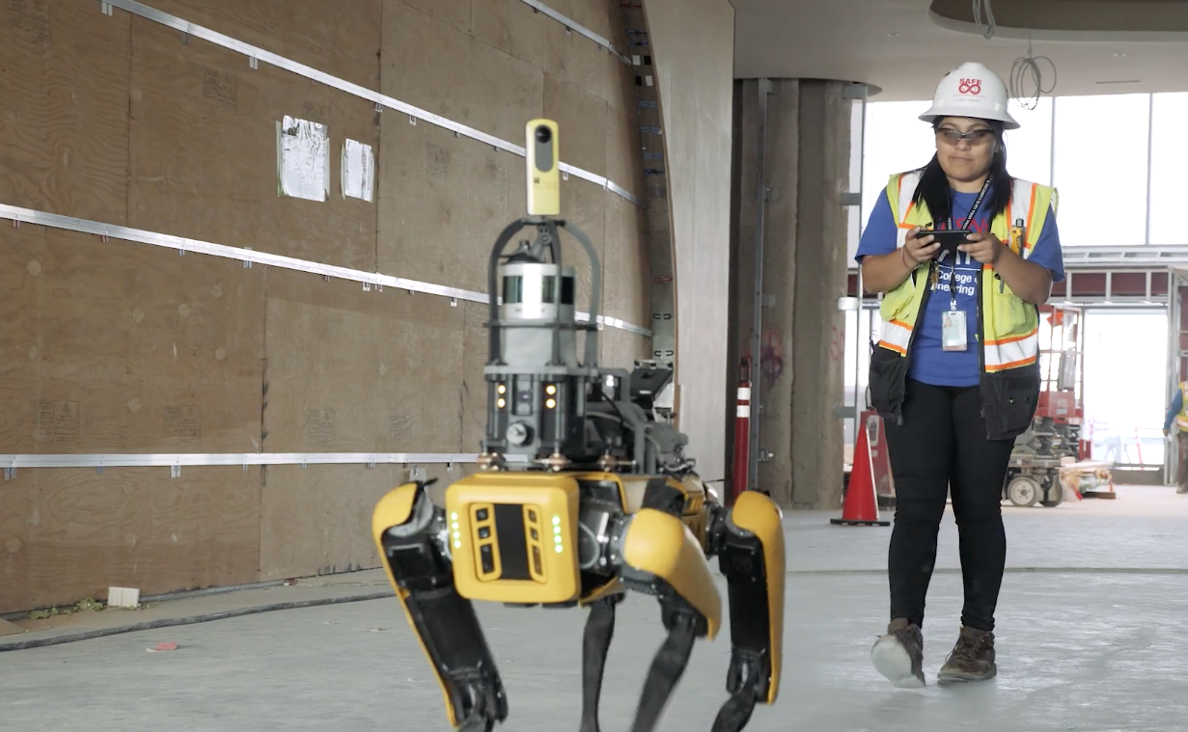
Boston dynamics: construction
WORTH IT?
ROBOT COST?
OPERATOR?
ONE PER JOB?
SOFTWARE COST?
ONSITE VS. OFFSITE?

Slide 8
Buyer beware

Slide 9
AI In CONSTRUCTION
Generative Design
Photo/Video Processing
Risk Mitigation
Schedule Creation

Slide 10
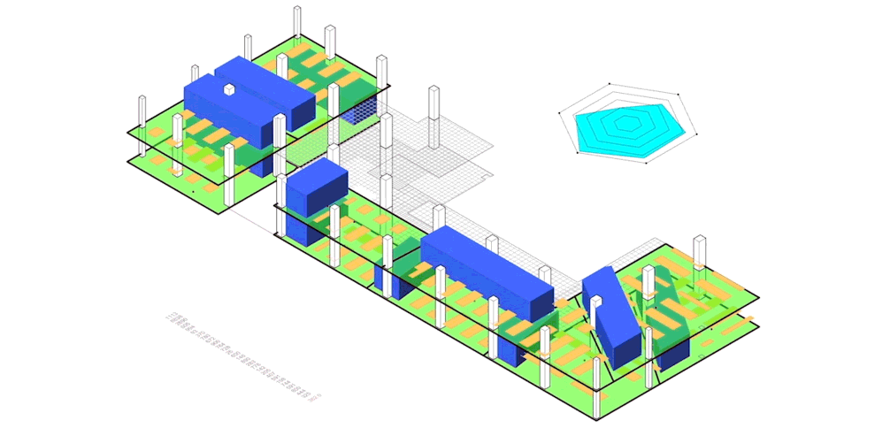
Generative design
Input: Performance, Spatial, Materials, Cost, Constraints
Output: Possible Cases
Rinse & Repeat

Slide 11
GENERATIVE DESIGN EXAMPLE: TESTFIT

Slide 12
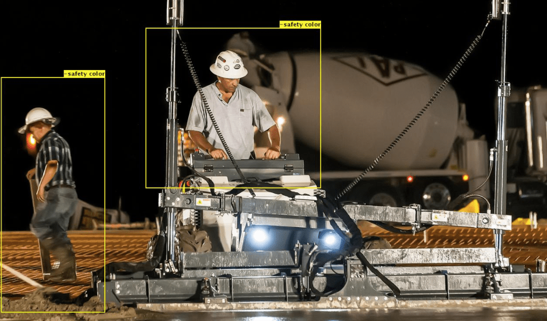
Photo processing: smartvid.io
HARD HATS
SAFETY VESTS
COLORS
JOBSITE HAZARDS
WORKERS AT HEIGHT
FALL HAZARDS

Slide 13
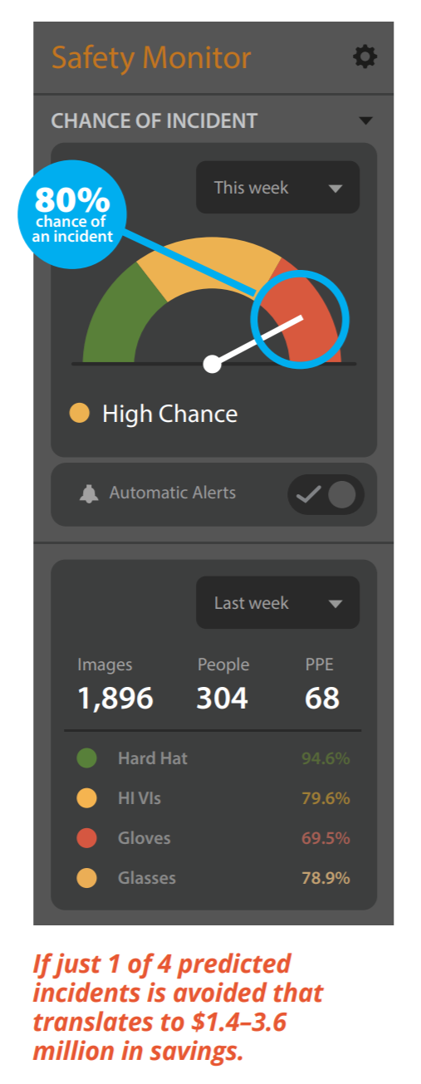
RISK MITIGATION: SMARTVID.IO
DAILY REPORTS
PHOTOS
SCHEDULES
PROJECT TYPE
PHASE
WEATHER
HOW MANY PROJECTS HAVE YOU COMPLETED?

Slide 14
Photo processing: structionsite
***ADD VIDEO***

Slide 15
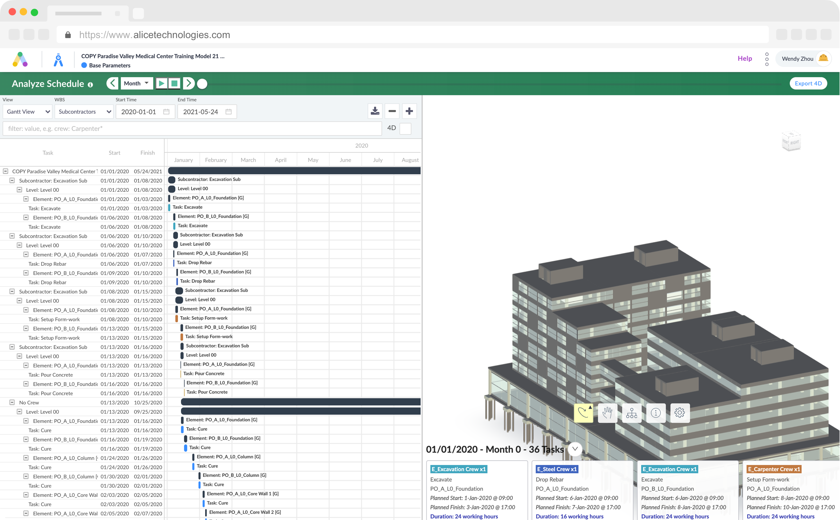
Schedule: alice
CONSTRAINTS
PROCESS
PRODUCTION RATES
CONSTRUCTION COSTS
OPTIMIZE
BLACK BOX TRAP

Slide 16
You have the power (AKA DATA)
FACEBOOK IS FREE BECAUSE USERS
PROVIDE THE DATA
HARD FOR “TECH” COMPANIES TO COLLECT ENOUGH DATA TO MAKE USEFUL AI….YOU HAVE THIS DATA.
SMARTVID IS SMART BECAUSE OF SUFFOLK CONSTRUCTION

