Slide 1
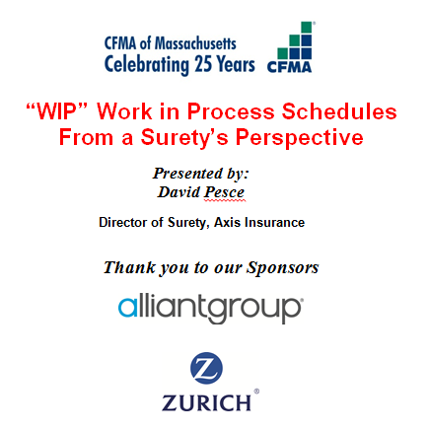

Slide 2
The WIP
A Surety’s Deep Dive
David Pesce, CCIFP
Director of Surety
AXIS Insurance
300 Connell Dr., Suite 8000
Berkeley Heights, NJ 07922
david.pesce@axiscapital.com

Slide 3
WIP - A Surety's Deep Dive
Review of the Basics
Financial Statement Tie Back
Trend Analysis
Real Examples of what the WIP can do to bonding

Slide 4
WIP - A Surety's Deep Dive The Basic Calculations

Slide 5
WIP - A Surety's Deep Dive The Basic Calculations – Pure Job Borrow
Only applicable to jobs with Overbillings
Billings in excess of Costs, not B/C+EE
The amount beyond your total profit you have billed in advance
At some time this will have to be “repaid”
Calculation
Calculate Billings to Date – Cost to Date (B/C)
B/C – Total Est. Profit = Pure Job Borrow

Slide 6
WIP - A Surety's Deep Dive Tie Back to Financials
A WIP Must Tie Back to the Financials
For CPA statements, this is “as must”
Supplemental information
Exclusion of these schedules will affect bonding
For internal information it is still important
Indicative of the quality of the information
Completed Contract information just as important as the Work in Progress

Slide 7
Schedule 1 / Schedule 2 – Relation
WIP - A Surety's Deep Dive Tie Back to Financials

Slide 8
Schedule 2 – Completed Contracts
WIP - A Surety's Deep Dive Tie Back to Financials
Total Contract Activity
Prior Year Activity
Current Year Activity
Ties back to Schedule 1

Slide 9
Schedule 1 / Schedule 3 – Relation
WIP - A Surety's Deep Dive Tie Back to Financials

Slide 10
Schedule 3 – Contracts in Progress
WIP - A Surety's Deep Dive Tie Back to Financials

Slide 11
Schedule 3 – Contracts in Progress
WIP - A Surety's Deep Dive Tie Back to Financials
Current Year Activity
Ties back to Schedule 1

Slide 12
Schedule 1 – Earnings from Contracts
WIP - A Surety's Deep Dive Tie Back to Financials

Slide 13
Schedule 1 / Statement of Earnings – Relation
WIP - A Surety's Deep Dive Tie Back to Financials
Ties back to Schedule 1

Slide 14
Underbillings and Overbillings
WIP - A Surety's Deep Dive Tie Back to Financials
Underbillings
Overbillings

Slide 15
Underbillings and Overbillings
WIP - A Surety's Deep Dive Tie Back to Financials

Slide 16
WIP - A Surety's Deep Dive Trend Analysis
All WIP’s and Completed Contract Schedules are entered and tracked
Underwriter will look for discernible trends
In individual jobs
Also over many jobs and many periods
Trends can and will change an Underwriter’s view of an account
Both positively and negatively

Slide 17
WIP - A Surety's Deep Dive Trend Analysis

Slide 18
WIP - A Surety's Deep Dive Example #1 – Underbillings to Profit Fade

Slide 19
WIP - A Surety's Deep Dive Example #1 – Underbillings to Profit Fade

Slide 20
WIP - A Surety's Deep Dive Example #1 – Underbillings to Profit Fade

Slide 21
WIP - A Surety's Deep Dive Example #2 – Overbillings to Profit Increase

Slide 22
WIP - A Surety's Deep Dive Example #2 – Overbillings to Profit Increase

Slide 23
WIP - A Surety's Deep Dive Example #2 – Overbillings to Profit Increase

Slide 24
WIP - A Surety's Deep Dive Example #3 – Creating a P&L
Used when no financials are provided
Must have items to calculate
Open Jobs
Completed Projects
Estimates are used when not provided
Prior FYE Open Jobs
Estimates are used when information is not provided

Slide 25
WIP - A Surety's Deep Dive Example #3 – Creating a P&L

Slide 26
WIP - A Surety's Deep Dive Example #3 – Creating a P&L

Slide 27
WIP - A Surety's Deep Dive Example #3 – Creating a P&L/P&L Reconciliation

Slide 28
WIP - A Surety's Deep Dive Example #4 – Cash Flow in WIP Analysis

Slide 29
WIP - A Surety's Deep Dive
Questions??
David Pesce, CCIFP
Director of Surety
AXIS Insurance
300 Connell Dr., Suite 8000
Berkeley Heights, NJ 07922
david.pesce@axiscapital.com

