Slide 2
CFMA Suicide Prevention Summit
April 25, 2017

Slide 3
Welcome
Jennifer Murphy
Pleune Service Company
CFMA Western Michigan Chapter

Slide 4
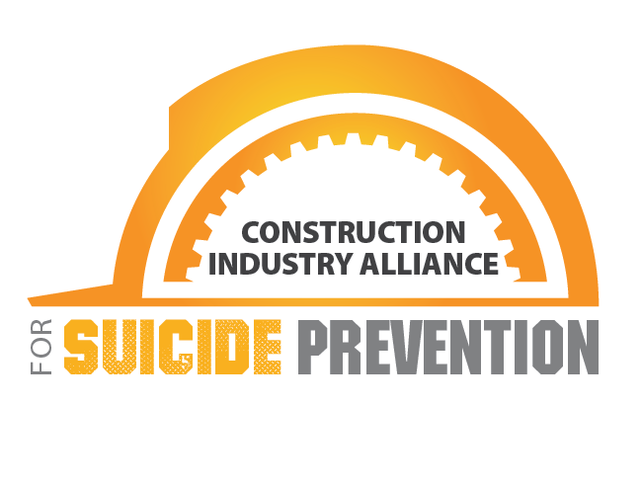
CFMA & Construction Industry Alliance for Suicide Prevention
Joe McLaughlin, CPA, CCIFP
CFMA Vice Chairman
Dallas/Fort Worth Chapter
Austin Industries, Inc.
Chief Accounting Officer
#SuicidePreventionCFMA

Slide 5
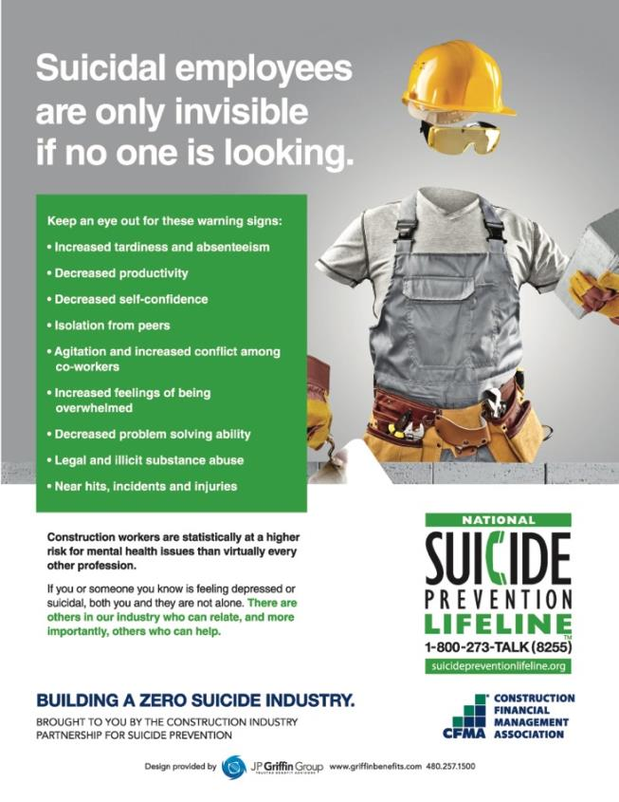
Why are we here?
Our people need us!
Notes:
1 in 5 adults are suffering from a mental illness at any given time, only about 10% of those will seek treatment
60 – 80% of individuals with mental health disorders will improve with early treatment
78% of individuals experiencing psychological distress are not receiving treatment
Estimated 90% of individuals who die by suicide were experiencing a diagnosable mental illness at the time of death
Depression estimated to cause 200 million lost workdays per year
In a 3 month period, individuals with depression miss an average of 4.8 workdays and suffer 11.5 days of reduced productivity
“The workplace is the last crucible of sustained human contact for many of the 30,000 people who kill themselves each year in the US. A co-worker’s suicide has a deep, disturbing impact on work mates. For managers, such tragedies pose challenges no one covered in management school.” This quote Sue Shellenbarger, Staff Reporter for the Wall Street Journal in 2001 raises two key reasons that the workplace is exactly the place to address suicide.

Slide 6
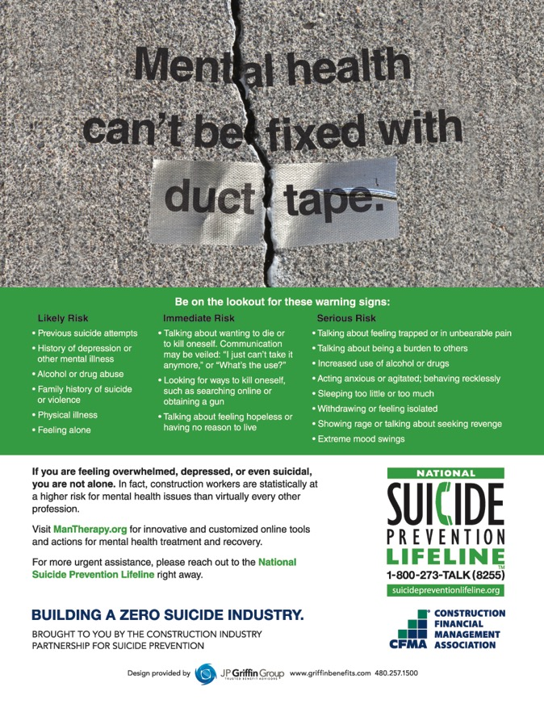
Why Construction?
Construction industry is #1 in number of suicides and #2 in suicide rate
Notes:
The construction industry is a breeding ground for issues affecting risk of death by suicide – large number of veterans, injuries/physical work, financial issues w/ seasonal employment, schedules leading to sleep disruption, lack of community – fragmented work force, macho- fear of sharing emotional issues, hiding pain/problems with drugs and alcohol, few long-term relationships where issues can be recognized and comfortably talked about

Slide 7
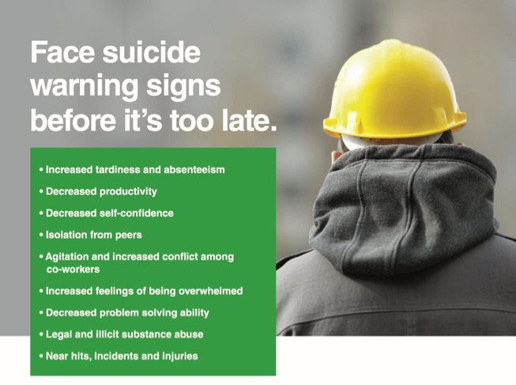
What can we do?
Embrace Mental Health and Wellness as much as they do Physical Wellness and create a Caring Culture
Notes:
Focus on the whole person: Teach coping skills – life training for stress mgmt, pain mgmt, conflict/anger mgmt, financial mgmt
Incorporate into company culture – safety programs - benefits
Include in toolbox talks, supervisor training

Slide 8
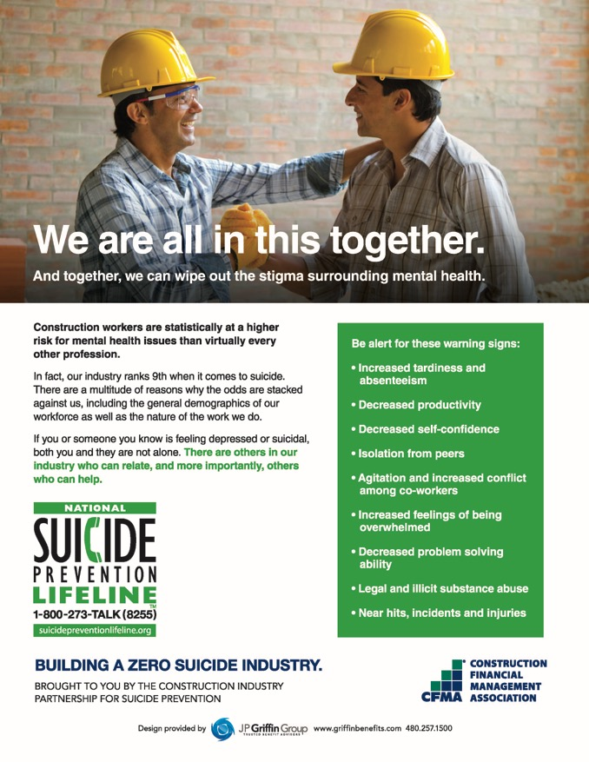
Where Are We At?
Notes:
In 12 months this has gone from a non-topic to a major industry wide initiative
If we can get the Engineering & Architecture community involved to tackle the A/E/C we are taking out #2 and #5 on the highest industry rate list
CFMA developing education program that can be widely distributed/utilized
CIASP will continue to build relationships with other associations and spread the word
Continue the conversation – remove the stigma – make it normal!

Slide 10
Lived Experience
Bob Swanson
Suicide Loss Survivor

Slide 11
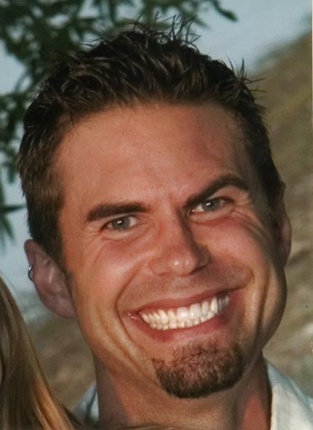
What do you see?
WHAT DON’T YOU SEE?

Slide 12
The Journey of Michael Swanson
Born on June 4, 1975
High School Mis-Diagnosis of Clinical Depression
Captain of High School Baseball Team
Attended Augsburg College
Head Trauma Injury at Age 23
Medication Side Effects and Self Medication
Died By Suicide on March 13, 2009 at the age of 33
Age 29 First Suicide Attempt and Diagnosis of Bipolar Disorder

Slide 13
Mental Illness Is…
An illness of the brain
TREATABLE

Slide 14
Common Traits of Mental Illness
Mental Illness
More than One
Alcohol or Drugs
Shame
Decision Making
Prescribed Medication
Anger
Usually more than one illness
Regular use of alcohol or drugs
Anger
Shame
Questionable decision making
Stop the use of prescribed medication(s)

Slide 15
Facts of Mental Illness
25%
25% of adults will experience a mental illness each year.
2
Anxiety disorders and depression are the two most common illnesses.
10%
10% of adults are addicted to alcohol and/or drugs.
60%
Approximately 60 percent of the adults with a mental illness did not receive any mental health services during the previous year.
1 or more
It is common to experience more than one illness

Slide 16
Facts of Suicide
42,773
There were 42,773 suicides in the United States in 2014.
1 Million
Suicide attempts each year in the United States.
4X
The suicide rate in 2012 for the construction industry was 53.3 per 100,000. This rate is 4 times the national average.
Alone
Suicide is usually a solo event.
They want to end the pain.
Preventable
Suicide IS preventable.

Slide 17
Suicide Myths
Don’t ask someone if they are thinking of hurting themselves because it will put the idea in their head.
People who talk about suicide don’t do it.
People who attempt suicide will not attempt suicide again.
Once a person has a suicidal plan they cannot be stopped.

Slide 18
Warning Signs of Suicide
Verbal clues
I wish I were dead
I’m tired of life
I’m a burden to everyone
Soon you won’t have to worry about me
Behavioral clues
Withdrawing from family and friends
Moodiness, hopelessness and unexplained anger
Putting personal affairs in order
Giving away prized possessions
Acquiring a gun or stockpiling pills
Situational clues
Loss of a job
Loss of major relationship
Diagnosis of terminal illness
Loss of family member or friend by suicide
Arrest and loss of freedom

Slide 19
Resources
Suicide Hotline – 1-800-273-TALK (8255)
911 – Ask for crisis intervention team (cit)
American Foundation for Suicide Prevention (AFSP) – www.afsp.org
National Alliance on Mental Illness (NAMI) – www.nami.org
National Institute of Mental Health (NIMH) – www.nimh.nih.gov
Suicide Awareness Voice of Education (SAVE) – www.save.org

Slide 20
Healthy Men Michigan
Jill Fontaine, M.Ed.

Slide 21
Healthy Men Michigan
Jill Fontaine, M.Ed.

Slide 22
Healthy Men Michigan
Jill Fontaine, M.Ed.

Slide 23
You Can’t Fix Your Mental Health With Duct Tape
Suicide Prevention in the Construction Field
Jill Fontaine, M.Ed
CommunityResponse Program Manager at Screening for Mental Health, Inc.
CFMA Western Michigan Chapter Suicide Prevention Summit
Postma Center at Pine Rest
Grand Rapids, MI
April 25, 2017
Notes:
Hello and thank you for joining us for this presentation.
This presentation will provide an overview of the increasing rates of suicide among working-aged men, with specific data on those who work in the construction industry, risk and protective factors, and how online screening programs can be an upstream strategy that can help get out in front of problems to prevent suicide among the population of men working in the construction industry.
Healthy Men Michigan is an example of a statewide mental health screening and awareness campaign, using online screening and resources to engage and educate about mental health and well-being with a focus on suicide prevention. The Healthy Men Michigan campaign offers free online mental health screenings, mental health educational information, and mental health resources for men throughout Michigan.
HealthyMenMichigan.org is open to anyone, but specifically designed to appeal to men and their loved ones.
Healthy Men Michigan provides immediate results based on the answers to a brief screen, followed by comprehensive local, statewide, and national mental health, substance use, and crisis resources.
The campaign is part of a larger research effort to evaluate innovative online programs to see what actually works for men to reduce suicidal thoughts and behaviors.
This research is supported by the Cooperative Agreement Number, shown here, funded by the Centers for Disease Control and Prevention.

Slide 24
This research is supported by the Cooperative Agreement Number, 1 U01 CE002661-01, funded by the Centers for Disease Control and Prevention. Its contents are solely the responsibility of the authors and do not necessarily represent the official views of the Centers for Disease Control and Prevention or the Department of Health and Human Services.
Notes:
This research is supported by the Cooperative Agreement Number, shown here, funded by the Centers for Disease Control and Prevention.

Slide 25
Middle-Aged Men and Suicide
Middle Aged Men and Suicide
“Although men in the middle years (MIMY)—that is, men 35–64 years of age—represent 19 percent of the population of the United States, they account for 40 percent of the suicides in this country. The number of men in this age group and their relative representation in the U.S. population are both increasing. If the suicide rate among men ages 35–64 is not reduced, both the number of men in the middle years who die by suicide and their contribution to the overall suicide rate in the United States will continue to increase.”
Suicide Prevention Resource Center (2016). Preventing suicide among men in the middle years: Recommendations for suicide prevention programs. Waltham, MA, Education Development Center, Inc. p. 3
Notes:
Suicide among middle-aged adults (35-64 years) is the fifth leading cause of death
has increased 29% since 2000
A recent report on suicide among middle-aged men suggested that…
Most suicide prevention services focus on youth and older adults – not middle aged adults and certainly not men (often white and middle class)
Without targeted interventions to engage men in assessment and mental health treatment, suicide will continue to increase among men in their middle years.
…“suicide will continue to compromise a significant proportion of the U.S. population for at least the next 25 years”
…“reducing the overall suicide rate in the U.S. requires making a substantial reduction in the suicide rate among men 35-64 years of age”.

Slide 26
Risk Factors for Men
Risk Factors for Men
Risks go well beyond mental health!
Financial problems
Alcohol and other drug abuse and dependence
Legal problems
Life stressors, including but not limited to relationship problems, job problems, intimate partner violence
Medical and health problems
Mental health problems often undiagnosed or misdiagnosed, depression, anxiety, post-traumatic stress
Notes:
Male depression, a risk factor for suicide, goes undiagnosed 50-65% of the time
Working-aged men are not only at high risk, but also hard to reach to engage in suicide problem identification and help-seeking behavior
Prior studies demonstrate that men are generally:
unwilling to acknowledge mental health problems or suicidal thoughts
less likely to access traditional and available service
(Galdas, Cheater & Marshall, 2005; Moller-Leimkuhler, 2002)

Slide 27
Construction is a “high risk” industry
Construction is a “high risk” industry
Industry Risk Factors
Access to lethal means
Capability for fearlessness
Exposure to physical strain or psychological trauma
Culture of substance abuse
Fragmented community/isolation
Humiliation/shame
Entrapment
Workplaces involved in community suicide deaths
Nature of the work
Sleep disruption
Notes:
According to a study published in July 2016 by the Centers for Disease Control and Prevention (CDC), people who work in construction and extraction had the 2nd highest rate of suicide – 53.3 per 100,00. This rate is more than 4 times the overall US suicide rate of 12.54 in 2012.
Industry Risk Factors Include (FROM http://www.constructionworkingminds.org/industry-risks.html)
(1) Access to lethal means: People who have access to, and familiarity with, lethal means like firearms, pills and high places, are often less afraid and more capable of self-inflicted harm by these means.
(2) Capability for fearlessness: When a workplace has a culture of recklessness, bravery and/or stoicism, and people are rewarded for being tough, they are often less likely to reach out and ask for help.
(3) Exposure to physical strain or psychological trauma: Workplaces that expose employees to physical or psychological injury through traumatic life-threatening events can experience symptoms of chronic pain, post-traumatic stress, or burnout that can contribute to suicide despair.
(4) Culture of substance abuse: Workplaces that informally support a culture of self-medication to relieve stress can experience escalating substance abuse problems that also increase the risk of suicide.
(5) Fragmented community/isolation: When workers are often in transitory or seasonal employment, they can experience a lack of belongingness and a higher level of uncertainty that adds to a sense of isolation and lack of meaning.
(6) Humiliation/Shame: When a humiliating job failure occurs and the employee’s main source of identity is their work, this event can trigger depression and suicidal thoughts.
(7) Entrapment: When employees feel that they must do something they would not normally do because they see no other way to meet their goals, hopelessness can result. Sometimes workers in the industry experience the “golden handcuffs” phenomenon: feeling entrapped into the one line of very stressful work because they see no other way to sustain a certain standard of life for themselves and their families.
(8)Workplaces involved in community suicide deaths: Construction sites that include bridges and buildings are sometimes the death sites for suicide. These types of community suicides can trigger suicidal thoughts or depression in job site workers.
(9)Nature of the work: Cyclical work with regular periods of lay-offs and re-hiring causes uncertainty about employment. Workforce and skill shortages result in laborers working overtime to complete projects. The combination results in a “pressure cooker” atmosphere that can overwhelm employees.
(10)Sleep disruption: Working long or abnormal hours can effect sleep, causing mental and physical exhaustion. This effects performance, increases the probability of injury, and can exacerbate other mental health concerns.

Slide 28
Working-Aged Men and Depression – Focus of Current Project
Even when depression is identified, men are reluctant to ask for help. WHY?
Masculine gender socialization and stereotypes
Perceived social stigma
Threat of being negatively labeled when seeking services
Co-occurring disorders such as alcohol abuse
Rigidity in sense of self and coping
Lack of knowledge about resources
(Davies & Waldon, 2003)
Notes:
Despite us knowing many of the risk factors described on the previous slide, men still don’t always acknowledge signs or symptoms of mental health problems they may be experiencing, such as depression, anger, and stress.
For depression, a major risk factor for depression, even when it is identified, men are often reluctant to ask for help, communicate inner feelings, or form groups around emotional issues.
Gender socialization, including traditionally masculine stereotypes, also play a role in men’ s behavior in seeking mental health treatment. Men who adhere more to self-perceived stereotypical masculine norms are less likely to seek help for mental health problems.

Slide 29
Protective Factors
Protective Factors
Several factors are beneficial in improving and supporting mental health and well-being and decreasing the risk of suicide:
Social relationships
Social integration
Notes:
CDC’s focus on promoting connectedness? http://www.cdc.gov/ViolencePrevention/pdf/Suicide_Strategic_Direction_Full_Version-a.pdf
(from CDC’s ‘promoting individual, family, and community connectedness to prevent suicidal behavior’)
Evidence from evaluations of interventions directed toward preventing suicidal behavior shows that connectedness promotion is a promising avenue for prevention.
CDC defines connectedness as the degree to which a person or group is socially close, interrelated, or shares resources with other persons or groups. This definition also comprises a wide range of concepts linked in the literature either theoretically or empirically to suicidal behavior, including social support, social participation, social isolation, social integration, social cohesion, and social capital.
Increasing connectedness among persons, families, and communities is likely to have a universal as well as a targeted effect on suicidal behavior. By supporting healthy interpersonal relationships (e.g., family, peer, and marital relationships), and by encouraging communities to care about and care for their members, the population at large is likely to experience more positive health and well-being, resulting in lower risk of suicidal behavior. Further, these connections can remove social barriers to help-seeking by those in need, so persons contemplating or planning suicide would be less likely to engage in life-threatening behaviors.
Several factors are beneficial in preserving mental health and decreasing the risk of suicide:
social relationships may promote well-being by encouraging adaptive behaviors like help-seeking and discouraging maladaptive behaviors such as suicidal behaviors (Cohen, Gottlieb & Underwood, 2001).
(2) Research shows that men benefit more than women from social integration, which includes participation in a broad range of social relations (Tsai, Lucas, Sania, Kim & Kawachi, 2014). Men who are involved in more social roles and have more social connections have better health outcomes than men who lack this important piece social integration (House, Landis & Umberson, 1988). The Interpersonal Theory of Suicide (Joiner, 2005) was used to develop MT and states that unmet interpersonal needs, including the unmet need to belong (thwarted belongingness) and the unmet need for social competence (perceived burdensomeness) contribute to wanting to die by suicide. A number of studies empirically support the associations between these interpersonal constructs and suicidal ideation and behavior (Davidson, Wingate, Rasmussen & Slish, 2009; Joiner, Pfaff & Acres, 2002; Joiner, Hollar & VanOrden, 2006; Joiner et al., 2009).
An internet-based connectedness intervention addresses many of the reasons that men give for not seeking help, and have demonstrated success in increasing social support.

Slide 30
Notes:
People often ask us, “Why Michigan?” First, Michigan has a lot of committed organizations and leaders who want to work to reduce suicide rates throughout the states. Michigan tends to have a higher than national average for suicide deaths and suicide is the leading cause of injury death among working-aged men in Michigan
Suicide is a significant public health problem
In 2014, there were 42,773 deaths by suicide in the U.S.
Suicide is the leading cause of injury death among middle-aged men in Michigan
Suicide among middle-aged adults (35-64 years) is the fifth leading cause of death
has increased 29% since 2000
Suicide among males is 4 times higher than among females
Male deaths represent 79% of all U.S. suicides
Middle-aged men are not only at high risk, but also hard to reach to engage in suicide problem identification and help-seeking behavior. Prior studies demonstrate that men are generally:
unwilling to acknowledge mental health problems or suicidal thoughts
less likely to access traditional and available service
Even when depression is identified, men are reluctant to ask for help. WHY?
Masculine gender socialization and stereotypes
Perceived social stigma
Threat of being negatively labeled when seeking services
Co-occurring disorders such as alcohol abuse
Rigidity in sense of self and coping
Lack of knowledge about resources
Male depression, a risk factor for suicide, goes undiagnosed 50-65% of the time
Working-aged men are not only at high risk, but also hard to reach to engage in suicide problem identification and help-seeking behavior

Slide 31
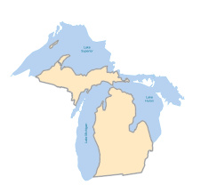
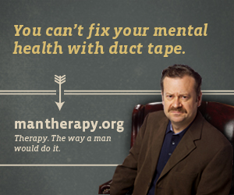
Response to the Problem – Healthy Men Michigan
Comprehensive online screening and referral intervention, integrating two existing, and promising, online programs
Screening for Mental Health
Man Therapy
Notes:
This research study is designed to educate men about the benefits and efficacy of treatment for depression and suicide, and to reduce barriers to help-seeking behavior by decreasing stigma, increasing social support and providing appropriate, convenient and effective referrals for treatment.
To date, no research has evaluated the combined effects of this comprehensive program of online screening for mental health (Screening for Mental Health) and male-focused intervention services to prevent suicide (Man Therapy).
Use of the two online programs together is hypothesized to result in:
Increase in help-seeking behavior
Greater use of online and community referral resources
Reduction in depression symptoms and suicidal ideation and behaviors
In merging the programs, SMH is the lead in development and dissemination of the statewide campaign and materials. We work with MT to introduce ideas for marketing and promotion that are inline with men’s mental health and MT, but the MT alone are not being used in the promotion of this project.
Merging these two programs is in line with how the CDC views suicide as a form of violence. Viewing suicide as a form of violence and not just a mental health problem lends it to then be considered a public health problem that requires a comprehensive approach to solving a multifaceted problem. Suicide, like other forms of violence such as child abuse and neglect, intimate partner violence, sexual violence, youth violence, elder abuse and neglect all share common risk factors and therefore a goal is to prevent violence by preventing other adverse life experiences can reduce risk for suicide.

Slide 32
Screening for Health, Inc. (SMH)
National Depression Screening Day
National Alcohol Screening Day
National Eating Disorders Awareness Week
Notes:
Screening for Mental Health (SMH) is one example of an online program connecting persons in need in the general public to quality treatment options provided through the community.
SMH is an established organization providing online screening and referral services to community members interested in their mental health and wellbeing. Its online self-assessments allow users to screen for a number of disorders and provide an assessment of the user’s mental health, information on the user’s assessment results, an overview of the signs and symptoms of treatable mental health disorders, and access to local, quality treatment options.
SMH has a successful history of creating mental health and wellness campaigns:
SMH’s flagship program is National Depression Screening Day which started in October 1991. It is the nation’s oldest voluntary community-based screening program that has provided a validated screening to more than half of a million people each year since.
National Alcohol Screening Day in April
National Eating Disorders Association for Eating Disorders Awareness Week in February
Online MH Screenings (benefits)
Privacy and confidentiality
Round the clock availability, accommodating different work schedules and locations
Accessible on multiple devices
Potential to increase access from those most hesitant about seeking traditional F/F counseling
Offer range of validated tools
Less than 1/5 EAPs use validated tools
Link back to EAPs and other resources

Slide 33
Man Therapy
Man Therapy
Therapy. The Way A Man Does It
Notes:
Part of a multi-agency effort, including the Colorado Office of Suicide Prevention, Carson J Spencer Foundation and Cactus, Man Therapy is giving men a resource they desperately need. A resource to help them with any problem that life sends their way, something to set them straight on the realities of suicide and mental health, and in the end, a tool to help put a stop to the suicide deaths of so many of our men.
Man Therapy (MT), an online program that will be offered in conjunction with SMH, provides this much needed additional service. MT is specifically designed for men who may be at risk for suicide and are generally less likely to engage in help-seeking behavior. At the center of the project is a web portal that allows men to interact with a fictional therapist, complete a self-assessment for depression and suicide, anger, substance use, and anxiety, review “manly mental health tips,” explore “man therapies” and view videos of men with lived experience.
*Click image to launch video about Man Therapy

Slide 34
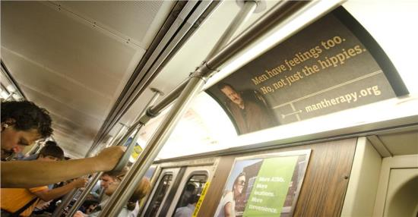
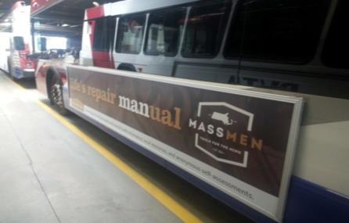
MassMen.org
Notes:
During the time of the grant proposal, an initiative was developing to merge SMH and MT resources in a statewide campaign in Massachusetts. Called Mass Men.

Slide 35
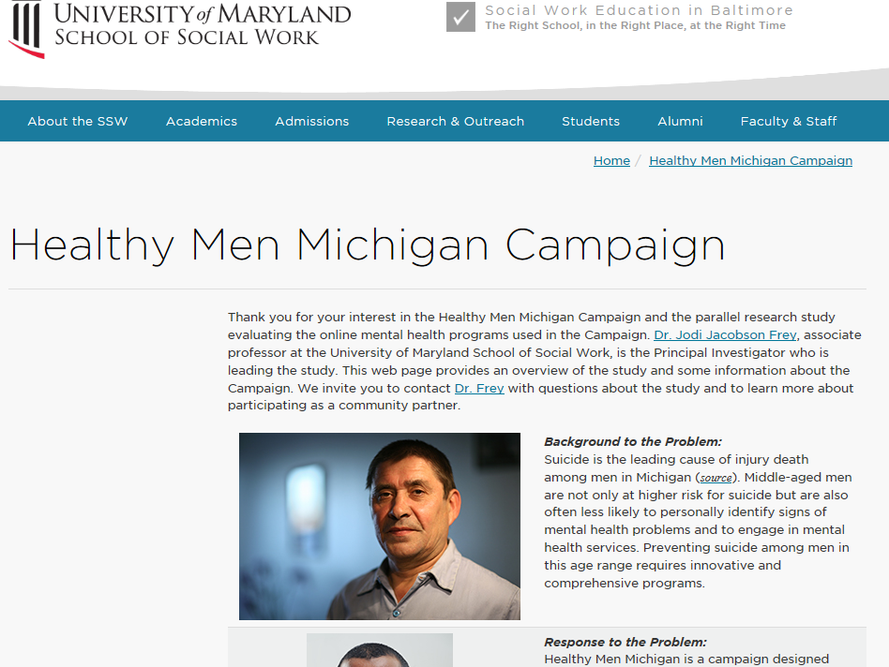
http://www.ssw.umaryland.edu/healthymenmichigan
Notes:
The purpose of the study is to test online mental health programs with men. The online programs aim to improve mental health and well-being, with a focus on depression and suicide prevention.
WHO WILL BE INVITED TO PARTICIPATE?
Men who voluntarily complete an online depression and suicide screening may be eligible to participate
The screening can be accessed through the Healthy Men Michigan Campaign or the National Depression Screening Day (Michigan) websites
The research team will recruit up to 300 middle-aged men by August 31, 2018
Participation in the research study is voluntary
There is no cost to participants
Men will be compensated for their time
The University of Maryland Baltimore will do all recruitment for the study.
WHAT WILL PARTICIPANTS RECEIVE?
Free online screening and referral services such as self-assessments for a number of mental health issues
Access to local, quality treatment options
WHAT WILL BE EXPECTED OF PARTICIPANTS?
Complete two follow-up, web-based surveys over the course of three months
WHAT WILL THE RESEARCHERS DO WITH THE DATA COLLECTED?
The results from this study may lead to developing online interventions to improve mental health and well-being services for men in the future.

Slide 36
Healthy Men Michigan:
Building Campaign Partners Throughout Michigan
Notes:
Our outreach strategy was to engage organizations, institutions, groups and individuals to help get the word out
We organized our outreach efforts into four groups (but there are natural overlaps) that consisted of approximately 1050 organizations/groups
Mental/behavioral health and suicide prevention orgs/groups
Education, safety/emergency, faith-based - fire/law enforcement/first responder, health centers/clubs, faith-based orgs
Business, social, recreational - chambers of commerce, barber shops, boat/yacht/gun/hunting/gentlemen clubs, casinos, sports organizations, bars, etc.
Male dominated - veterans/military, construction, first responder/PC, corrections/transportation/unions, fire/law enforcement/emergency services, etc.
We currently have 85 partner organizations and 140 individual partners.
I’ll conclude by sharing a number of ways in which you and/or your organization can help promote the campaign in Michigan.
Since the launch of HealthyMenMichigan, 891 individuals have taken a screening and been referred local resources in their community. A good number of people report that they are hearing about the campaign from their employer, in addition to word of mouth by family members, neighbors and friends, and health care and mental health providers. HealthyMenMichigan.org is actively working to meet men where they are at any time - at their home, workplace and in the community online. We are helping men learn that taking control of their mental health is a manly thing to do.

Slide 37
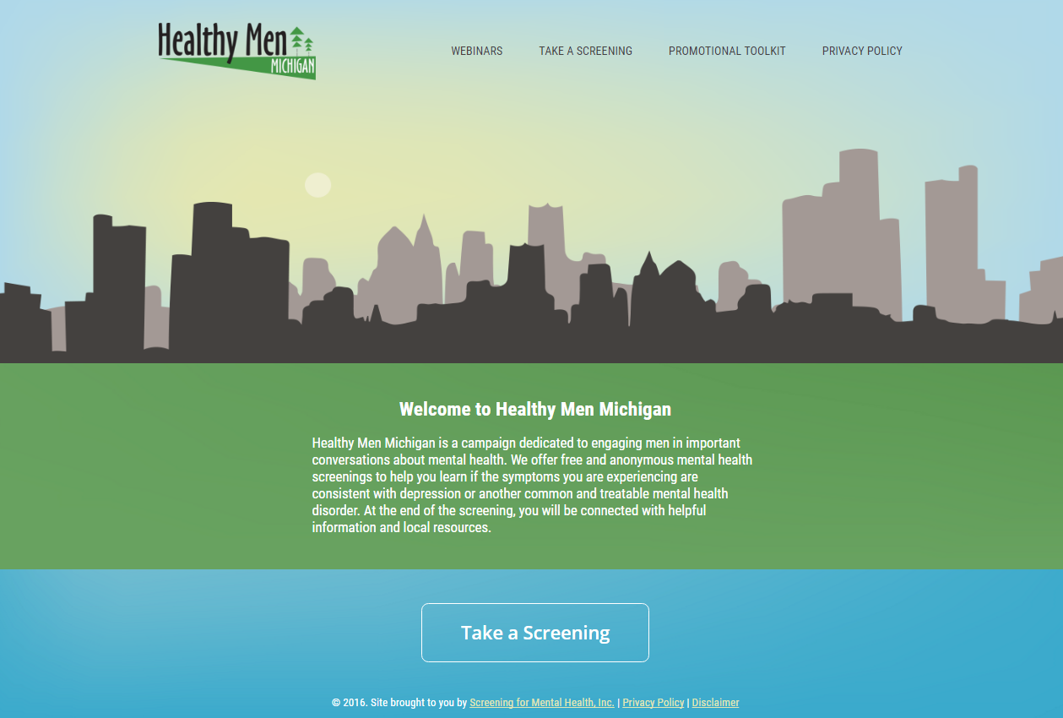
Notes:
Jill - .5 minute
Welcome to the Healthy Men Michigan Campaign Home Page at HealthyMenMichigan.org
The Campaign launched on September 26, 2016 and will be live through August 31, 2018.
As you can see from the home page, there is a brief description of the campaign, and the opportunity to take a screening.
We have also added a link to our previous webinars and a quick link at the top to the Healthy Men Michigan promotional toolkit, which we will discuss in more detail later in this presentation.
Once users have completed the screening, they will be given resources based on their geographic area.
Users who fit the criteria for the research study are able to opt in at the end of the screening.
Jill section – 5.5 minutes total

Slide 38
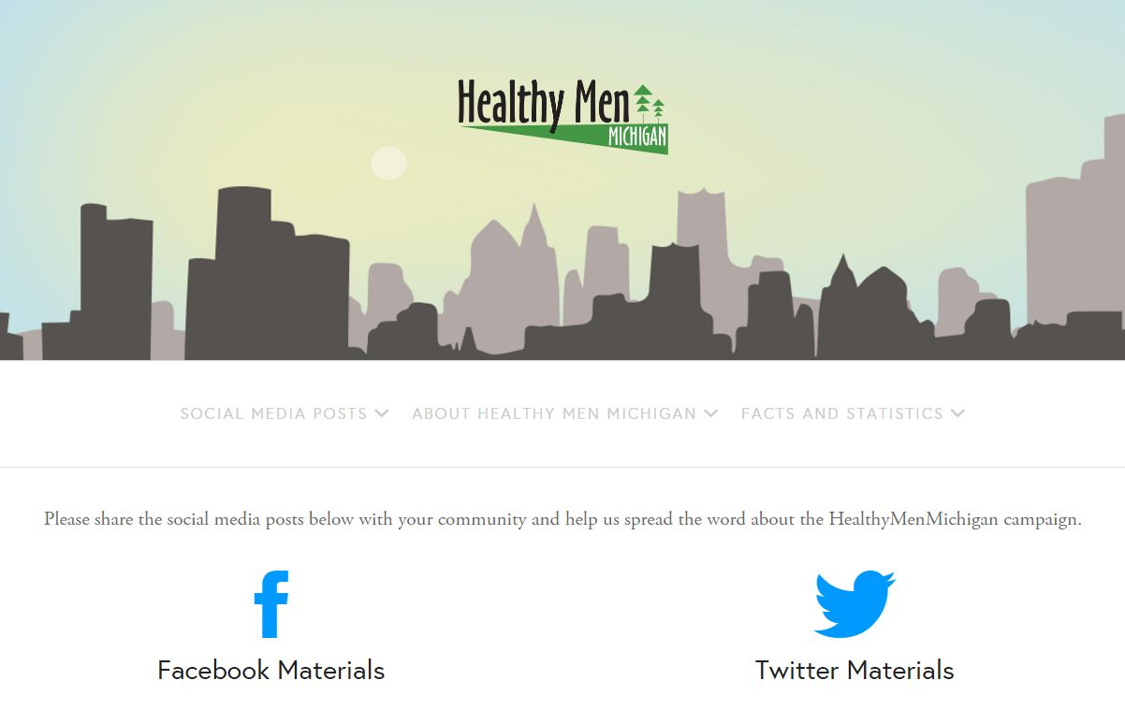
Notes:
As one of our valued partners on Michigan’s statewide campaign, we will work together to promote the initiative and encourage men to access the HealthyMenMichigan.org website. We will work with your organization to build mental health awareness activities and events, and provide customizable marketing materials to aide in your campaign efforts.
One free tool is the promotional toolkit found on the HMM homepage. The toolkit contains everything you need to tell the world about Healthy Men Michigan such as sample blog posts, social media images, social media posts, and more. It is your one-stop shop for promoting the campaign.

Slide 39
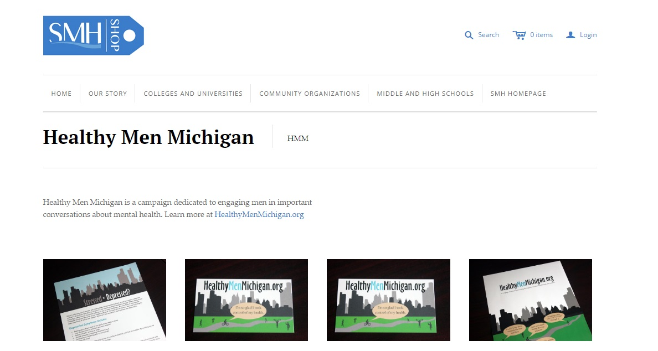
Online Shop:
Free Promotional Materials
shop.mentalhealthscreening.org/collections/healthy-men-michigan
Notes:
You can also order in-person materials to help promote the campaign as well. We have poster, coaster, flyers, and wallet cards. You can visit the online shop and order these materials free of charge!

Slide 40
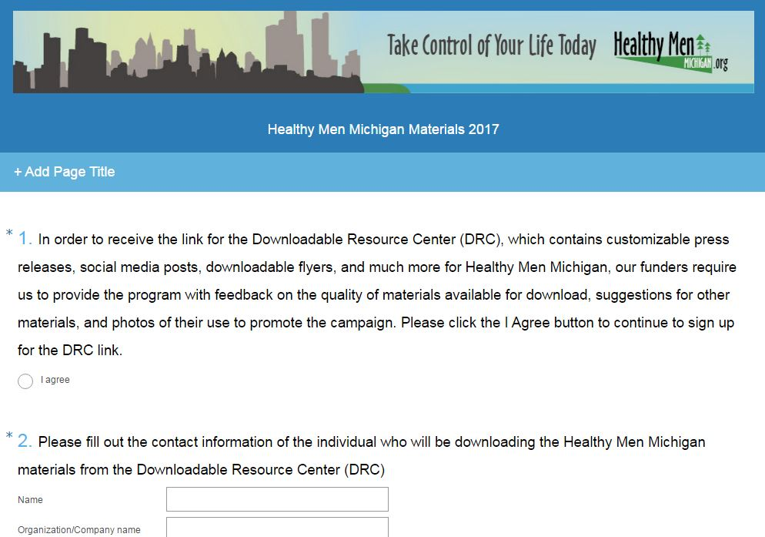
Downloadable Resource Center
Downloadable Resource Center
Use our link to access the DRC!
Complete the survey after accessing the DRC to tell us how you are promoting.
Notes:
The Downloadable Resource Center or DRC is an additional tool you can use for promotion. It contains a press release that you can customize, as well as flyers and other promotional materials.
All we ask if that you fill out this survey so that we know how you are going to use the materials so we can track effectiveness of each outreach strategy. Once you have, we will provide you with the login information.

Slide 41
Notes:
Here is a great example of HealthyMenMichigan outreach! Barb Smith, Founder and Facilitator of the Saginaw Survivors of Suicide and partner on the Healthy Men Michigan campaign, sent us this photo of her outreach efforts.

Slide 42
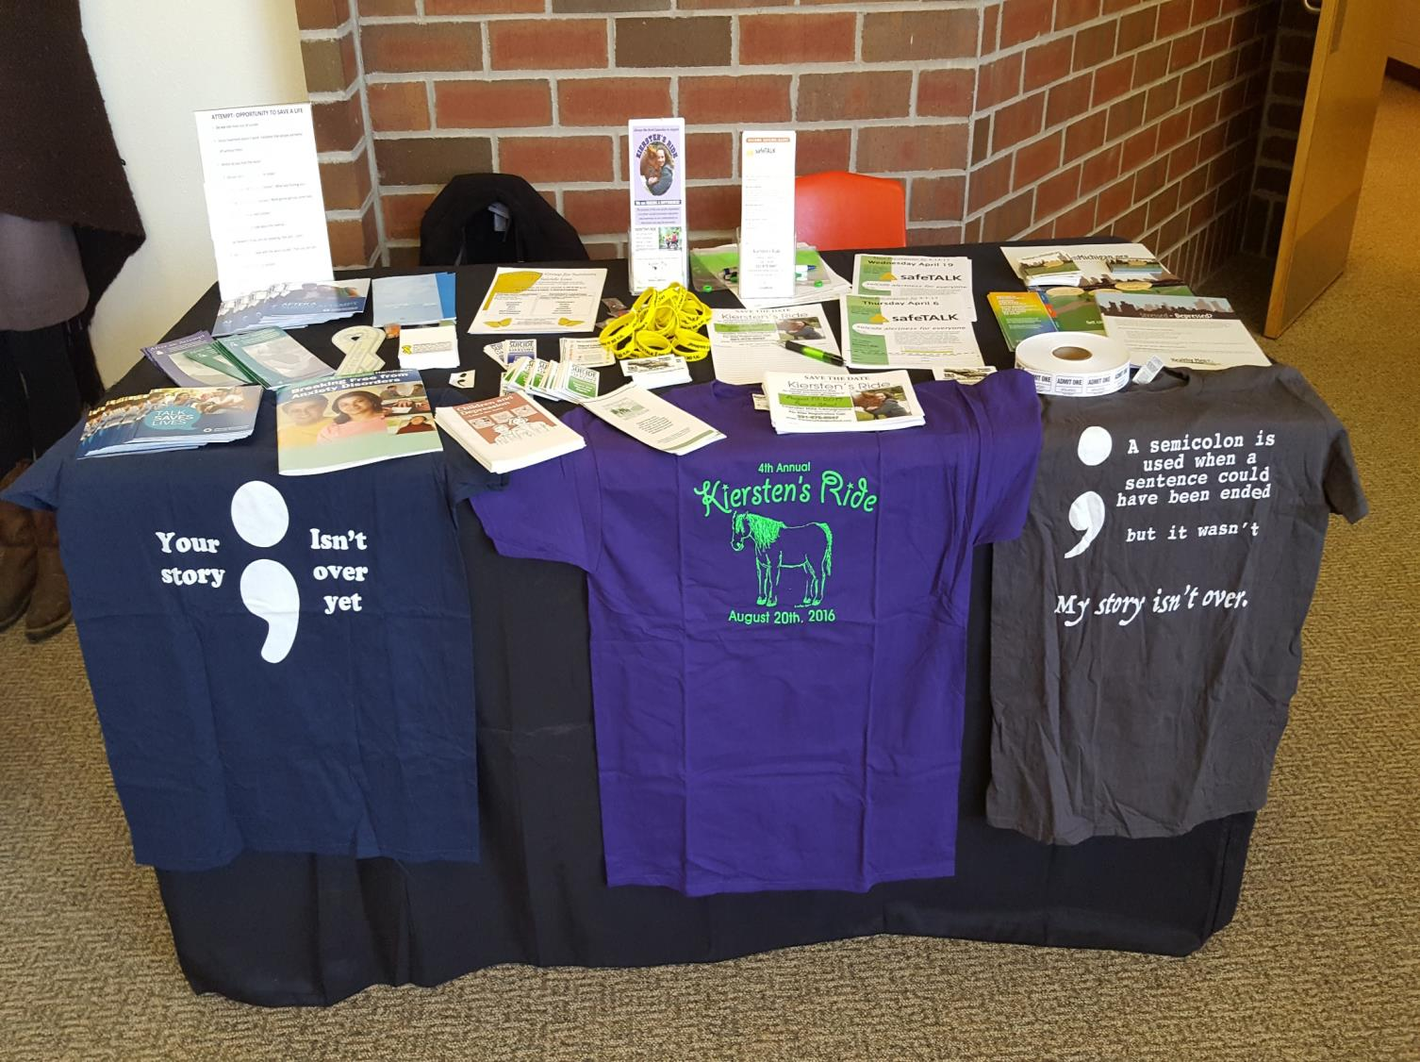
Notes:
Pictured here is another great example from one of our partners, of their full resource table setup in the community. This was sent to us by Lisa at Kiersten’s Ride and includes the Healthy Men Michigan promotional materials as part of their team’s community outreach efforts.

Slide 43
www.facebook.com/HealthyMenMichigan
twitter.com/HealthyMenMI
healthymenmichigan@mentalhealthscreening.org
healthymenmichigan.org
Notes:
You can also spread the word about the campaign by liking us on FB, following us on Twitter, emailing us, or visiting HealthyMenMichigan.org

Slide 44
Men in Michigan Are Taking Action Here’s How You Can Help
1. Social Media and Word of Mouth are how men are hearing about the campaign
Send promotional emails and social media posts to members of your community by using the ToolKit https://mentalhealthscreening.org/programs/hmm/toolkit
2. Michigan is a big state with lots of different areas to cover!
Help spread the word with free promotional materials while you are out across Michigan shop.mentalhealthscreening.org/collections/healthy-men-michigan
3. The workplace is another great place to promote the campaign!
Add a link to www.HealthyMenMichigan.org on your organization website and newsletter
Send a link to www.HealthyMenMichigan.org to your employees/colleagues
4. There are lots of ways to help get the word out to more men across Michigan
Click the link in your email after the webinar to access the Downloadable Resource Center
5. Connect with us and stay up to date on the Healthy Men Michigan campaign
Email us at healthymenmichigan@mentalhealthscreening.org to sign up for the eNewsletter
Spread the word about men’s mental fitness in Michigan!
Notes:
Jill – 1.5 minute
Men want to take action and have a sense of control over their feelings. After this webinar, you can help take action too by choosing one or more of the Healthy Men Michigan campaign promotional efforts to do in just a few minutes today.
1. Social Media and Word of Mouth are how men are hearing about the campaign
Send promotional emails and social media posts to members of your community by using the ToolKit https://mentalhealthscreening.org/programs/hmm/toolkit
2. Michigan is a big state with lots of different areas to cover!
Help spread the word with free promotional materials while you are out across Michigan
shop.mentalhealthscreening.org/collections/healthy-men-michigan
3. The workplace is another great place to promote the campaign!
Add a link to www.HealthyMenMichigan.org on your organization website and newsletter
Send a link to www.HealthyMenMichigan.org to your employees/colleagues
4. There are lots of ways to help get the word out to more men across Michigan
Click the link in your email after the webinar to access the Downloadable Resource Center
5. Connect with us and stay up to date on the Healthy Men Michigan campaign
Email us at healthymenmichigan@mentalhealthscreening.org to sign up for the eNewsletter
Help the Healthy men Michigan team to spread the word about men’s mental fitness today!

Slide 45
Thank you for joining us today!
About the Research:
Dr. Jodi Jacobson Frey
410-706-3607
Healthymenmichigan
@ssw.umaryland.edu
About the Campaign:
Jill Fontaine
781-239-0071
Healthymenmichigan
@mentalhealthscreening.org
Notes:
Please promote HealthyMenMichigan.org to your communities and networks!
Thank you!

Slide 46
Lived Experience
Allied Electric

Slide 47
Handling Tragedy Together!

Slide 48
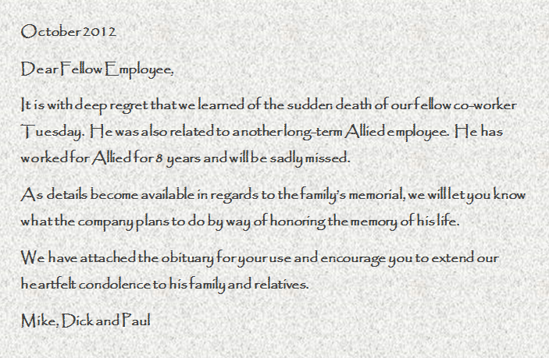

Slide 49
The Valuable Lessons We Learned
Understand that your company is a family, as dysfunctional as it may be!
Corporately you have to respond quickly.
Respond respectfully, humbly and quietly.
Give opportunities for your employees to respond to the event.
Do some benefit housekeeping.
It is not what is said, it is that something is said!

Slide 50
As a leadership team, you need to determine how to best be there for every employee in the company because it impacts all of them.
What my Grandma said:
I don’t remember a thing anyone said to me at Grandpa’s funeral, but I remember everyone who was there.

Slide 51
Break

Slide 52
Introduction of Bob VandePol
Chris Duprey
Granger Construction Co.
CFMA Lansing Chapter

Slide 53
Signs/Symptons/Prevention
Bob VandePol, LMSW
Pine Rest Christian Mental Health Services

Slide 54
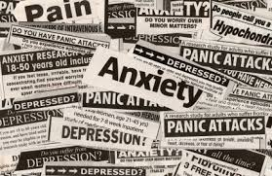
Completed Suicide Data
43,000 completed suicides in 2015
States that have the lowest risk (Rhode Island, Connecticut, New York, DC) also have the highest per capita funding for mental health
States that have the highest risk, (Nevada, New Mexico, Wyoming, Montana, Idaho, Alaska) have more limited access to mental health treatment
90% of those who die by suicide are suffering from a diagnosable mental health condition
Alcohol plays a major role in completed suicides, in approx. 50% of completed suicides the individual has a blood alcohol level above the legal intoxication level

Slide 55
117 deaths by suicides per day
10th leading cause of death for all ages
2nd leading cause of death for men 25-54 in the United States
78% of suicides are by men
51% with guns
25 attempts for every suicide
Survivors significantly impacted for every suicide
Notes:
Cal Beyer section – 10 minutes total

Slide 57
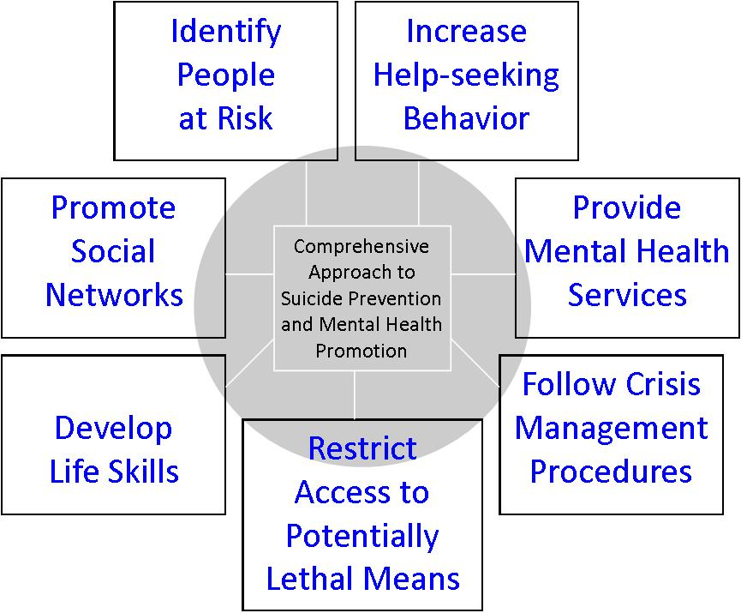
Adapted from SPRC/TJF

Slide 58
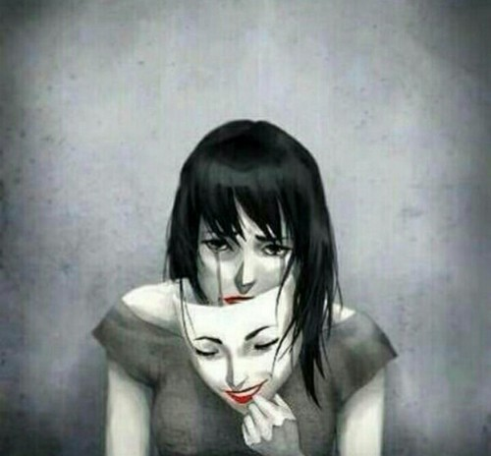
Who is at Risk?

Slide 59
Identify Risk - Danger Signs
Depression
Alcohol
Negativity
Giving life away
Estrangement
Rage/Revenge

Slide 60
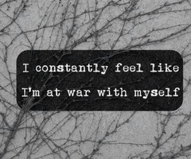
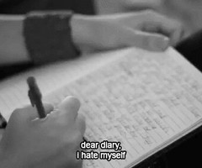
Identify Risk - Warning Signs
• Talking about wanting to die
• Looking for a way to kill oneself
• Talking about feeling hopeless or having no purpose
• Talking about feeling trapped or in unbearable pain
• Talking about being a burden to others
• Increasing the use of alcohol or drugs
• Acting anxious, agitated or recklessly
• Sleeping too little or too much
• Withdrawing or feeling isolated
• Showing rage or talking about seeking revenge
• Displaying extreme mood swings
The more of these signs a person shows, the greater the risk. Warning signs are associated with suicide but may not be what causes a suicide.

Slide 61
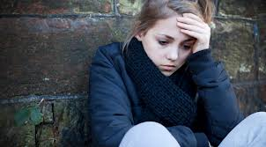
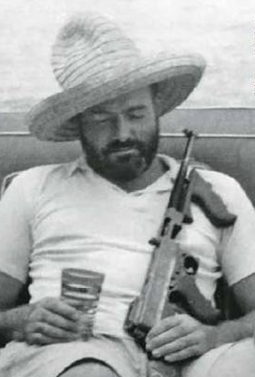
Escalation: Co-Occurring Risk Factors
Upset/
Distraught
Alcohol
Lethal Triad
Firearm

Slide 62
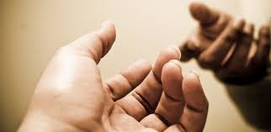
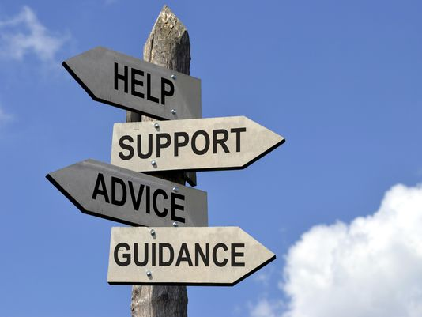
Suicide Protective Factors
Easy access to effective clinical care
Support for help-seeking
Restricted access to highly lethal means
Strong family and community connections
Skill in problem solving, conflict resolution, and nonviolent handling of disputes
Religious faith that discourages suicide and supports self preservation

Slide 63
Exercise
Pair up
Discuss: Imagine yourself with any combination of the risk factors and trigger events plus an erosion of your protective factors.
Who would you tell?
What would you say?

Slide 64
What To Do
If someone you know exhibits warning signs of suicide:
ASK! QPR – Question, Persuade, Refer
Do not leave the person alone
TELL!
Remove any firearms, alcohol, drugs or sharp objects that could be used in a suicide attempt
Call the U.S. National Suicide Prevention Lifeline at 800-273-TALK (8255)
Take the person to an emergency room or seek help from a medical or mental health professional

Slide 65
For the strength of the pack is the wolf….
And the strength of the wolf is the pack

Slide 66
The Value of Community
September 11, 2001

Slide 67
Exercise
Pair up
Maintain eye contact with your partner
Say “I care about you enough to risk ticking you off. Your recent behavior concerns me. Are you thinking about killing yourself?”
Switch roles

Slide 68
Care Enough to Risk Over-Reacting
The Communication Vortex
Small bits of concerning behavior or communication are noticed in different areas of a person’s life. By themselves they are not necessarily alarming, but when pulled together, they can paint a very concerning larger picture.
Communicate!

Slide 69
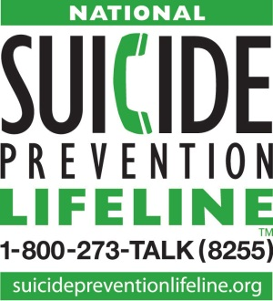
A free, 24/7 service that can provide suicidal persons or those around them with support, information, and local resources.

Slide 70
Contact Information
Bob VandePol
Pine Rest Christian Mental Health Services
www.Pinerest.org
Bob.vandepol@pinerest.org
616-258-7548

Slide 71
Lived Experience
Vonnie Woodrick
Suicide Loss Survivor

Slide 73
i understand is a non-profit organization to support those who have lost a loved one by suicide or struggle with mental illness.
Based in Ada, Michigan, i understand provides compassionate comfort to individuals and communities by hosting monthly educational awareness events. Through a partnership with Helen DeVos Children's Hospital, i understand delivers mental health care packages to patients in West Michigan and families around the world.

Slide 74
What We Believe:
i understand suicide is an effect of an illness
i understand mental illnesses are treatable
i understand stigma is the #1 reason why someone would not seek treatment for mental illness; education and awareness are vital to saving and changing lives
i understand reaching out to those who are suffering could save a life; let someone know you are available and treat them with respect and compassion
i understand most people who are suicidal do not want to die; they want their pain to end
i understand speaking out about suicide may empower others to share their stories
i understand feelings of guilt are part of the grieving process on the way to finding peace and acceptance
i understand those who die by suicide do make it to heaven

Slide 75
National Suicide Prevention Lifeline Call 24/7 800-273-8255
Crisis Text Line TEXT CONNECT TO 741741
Website: iunderstandloveheals.com
Stay Connected:
Facebook.com/iunderstandloveheals
Instagram: @iunderstand_loveheals

Slide 76
Panel Discussion

Slide 77
Wrap Up
Ken Bos
Hylant
CFMA SW Michigan Chapter

