Slide 1
Understanding 3(16) Fiduciary Services
Presented by
Patrick M. Fay

Slide 2
Agenda
Overview
Fiduciaries
Guide to 3(16) Service Providers
Payroll Data

Slide 3
Four Core Components
PLAN
Administration & Compliance
Investments & Recordkeeping
Plan Sponsor
Investment Advisors

Slide 4
Overview
Plan Sponsor
Fiduciary
Plan Administrator
Investment Advisor
Provides investment expertise to plan sponsor and participants
Can be a fiduciary under ERISA 3(21) or 3(38)
TPA: Administration and Compliance
Administers the plan and performs compliance testing
3(16) Administrator
Co-Fiduciary with plan sponsor
Performs some or all of the services required of a plan sponsor

Slide 5
Plan Sponsor responsibilities
Employee resigns: Send paperwork, manage exit, approve withdrawals, update recordkeeper
Deferral changes: Approve and update recordkeeper website
Loan request: Approve loan, provide package, submit payment to recordkeeper
New employee: Provide required data to employee & recordkeeper
Annually: Provide fee disclosures, summary annual report, summary plan description, notices, IRS limits
Every payroll: Upload contribution files to recordkeeper, provide census
Plan Sponsor

Slide 6
Fiduciary Responsibilities
Department of Labor:
The plan sponsor can hire a service provider(s) to handle fiduciary functions
Fiduciary Guidelines:
Run plan solely in interest of participants
Diversify investments to minimize risk and pay reasonable fees
Follow provisions of the plan documents
Document actions
Avoid conflicts of interest

Slide 7
Fiduciaries: 401(k) Plan Mistakes (identified by irs)
Not following terms of plan document
Not amending plan document
Not applying correct definition of compensation
Calculating wrong matching contribution
Failed ADP/ACP test
Deferral eligibility
Timeliness of deposits
Loan errors
Hardship withdrawal
Incorrect top heavy minimums
5500 filing errors

Slide 8
Fiduciaries: Common administration mistakes
Identifying and notifying eligible participants
Rehire eligibility
Auto-enroll and auto-increase
Incorrect hardship documentation
Incorrect loan administration
Duplicate payroll submissions
Multiple participant accounts
Beneficiary form errors

Slide 9
Fiduciaries: impact on plan sponsor
Mistakes occur for two primary reasons:
Plan not administered according to document
Payroll data
All recordkeepers accept data without review or responsibility
Proceed with data on file without analyzing for errors
Payroll integration is not well-defined

Slide 10
Fiduciaries: Why 3(16)?
Why consider a 3(16)?
Taking on plan sponsor roles and responsibilities
Expertise with retirement plan compliance and regulations
Avoid common plan pitfalls
Who hires a 3(16)?
Employers with lean staff; loss of long-tenured employee
Concerned about liability
Staff expertise in other areas
High employee turnover

Slide 11
Guide: 3(16) fiduciary services
Service models: Guide to the Marketplace
Named 3(16) Fiduciary
Complete service model
Outsourced Services
3(16) service performed by recordkeeper
Full data integrity checks
Quarterly reports
Manage tasks and act based on recordkeeper data
Ad hoc
Administrative tasks requested by plan sponsor
Add-on to TPA service
Can work with any payroll software
Not a named fiduciary

Slide 12
Guide: Plan Sponsor and 3(16) Administrator
Plan Sponsor Responsibilities
Monitor delegated fiduciaries
Benchmark plan fees
Provide accurate and timely payroll data
Timely contribution submissions
Follow instructions from 3(16)
Make corporate decisions
3(16) Administrator
Responsibilities
Administer plan consistent with document
Determine eligibility
Provide enrollment materials
Approve distributions & loans
Notices
Sign and submit 5500

Slide 13
Payroll data:
The importance of payroll data
Payroll data is the engine that runs every benefit provided to employees.
What creates unhappy clients? Plan errors. When a plan has errors, clients are confused and upset and call…you.
So what causes plan errors? The answer, nearly ALWAYS, is errors in payroll data. These errors occur often and are not checked by recordkeepers, but simply used to execute tasks.

Slide 14
Payroll data: integration
Payroll integration
180 integration: data flows automatically – payroll software → plan recordkeeper
360 integration: data flows automatically – payroll software ←→ plan recordkeeper

Slide 15
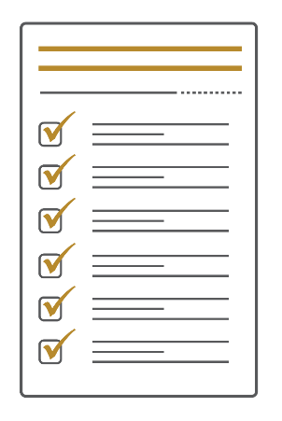
Client experience with 3(16)
Client
Client submits payroll
3(16) TPA verifies data integrity, identifies any required updates
3(16) TPA sends required updates to recordkeeper and client

Slide 16
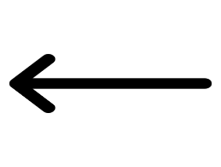
Plan sponsor experience
Deferral changes: Approve and update recordkeeper website
Employee resigns: Send paperwork, manage exit, approve withdrawals, update recordkeeper
New employee: Provide required data to employee & recordkeeper
Loan request: Approve loan, provide package, submit payment to recordkeeper
3(16) TPA
RUN
PAYROLL
Every payroll: Upload contribution files to recordkeeper, provide census
Annually: Provide fee disclosures, summary annual report, summary plan description, notices, IRS limits
Plan Sponsor

